Slide 1
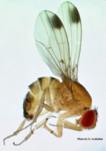
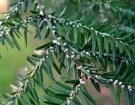
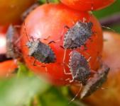
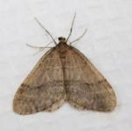
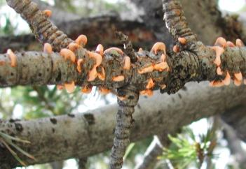
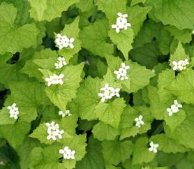
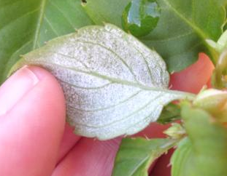
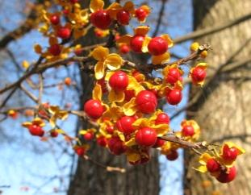
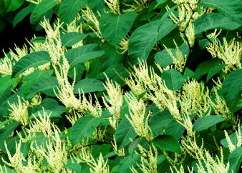
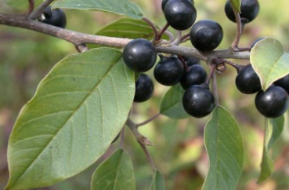
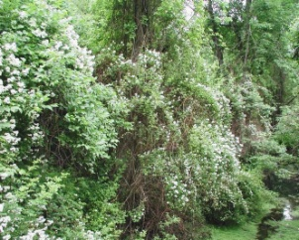
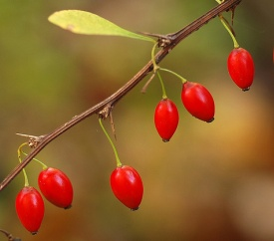
Maine’s most unwanted
Maine Department of Agriculture, Conservation and Forestry - BPC Trainings 2014

Slide 2
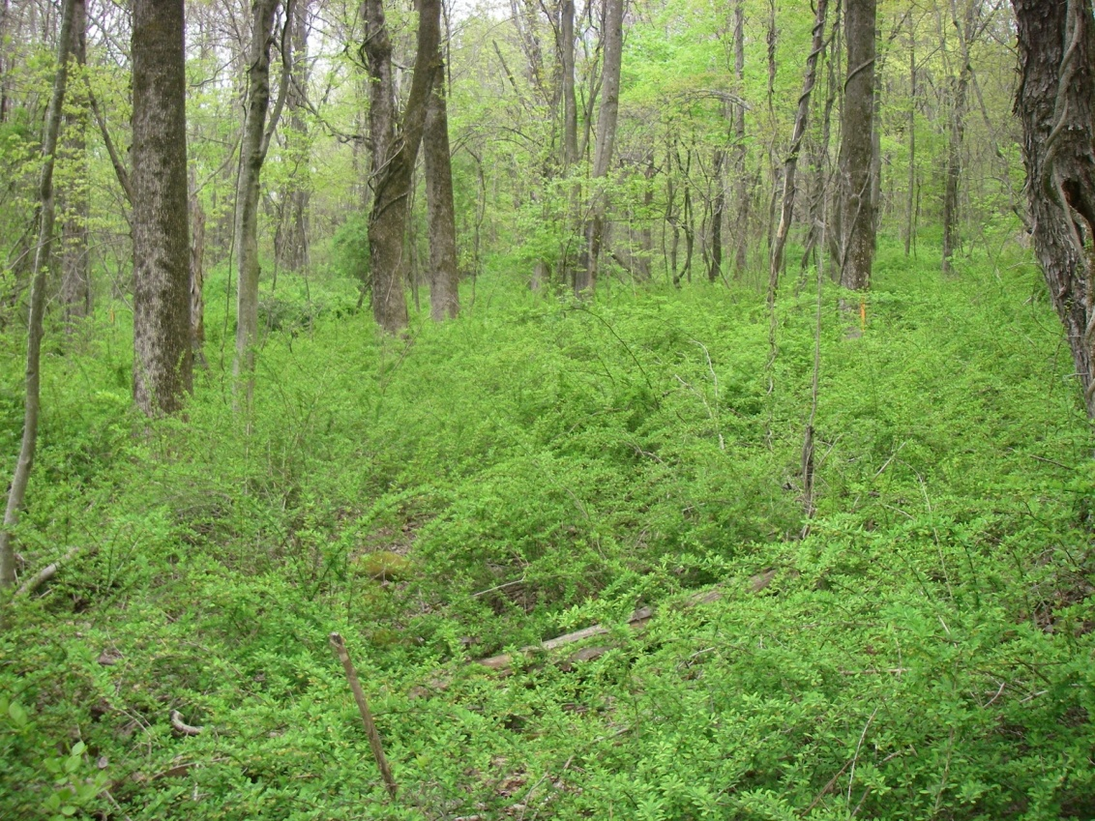
What are invasive species?
Are not naturally found in the area
Cause harm to:
    environment
    economy
    human health
Any benefits are outweighed by harm
Japanese Barberry, CTAES
Most non-native (alien) species are not invasive
Notes:
Photo: CT Ag Exp Stn

Slide 3
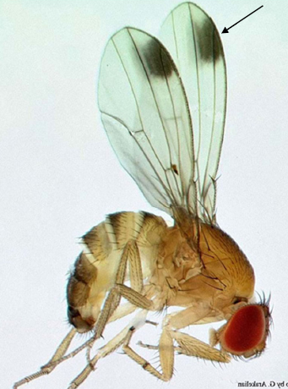
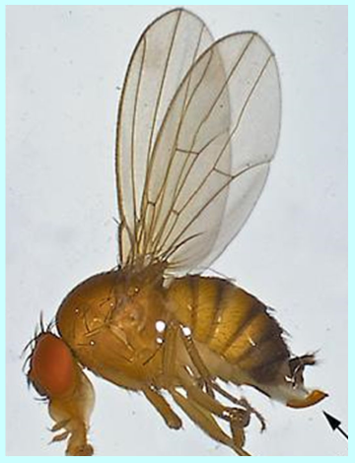
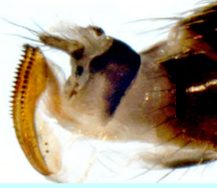
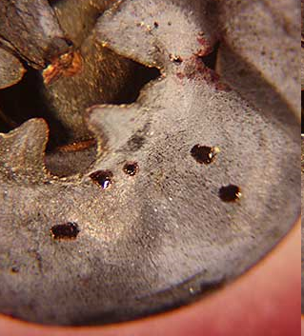
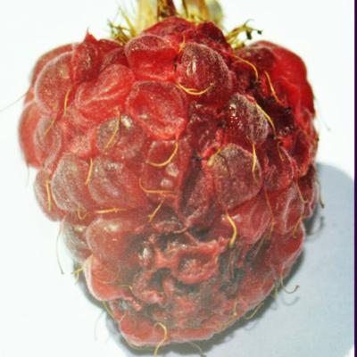
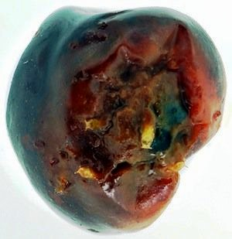
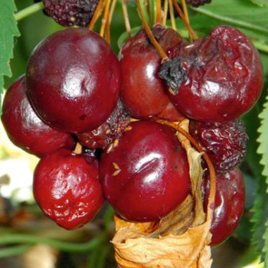
Spotted Wing Drosophila (SWD)
Drosophila suzukii
Vinegar Fly
Attacks ripening fruit
Prefers soft-skinned fruit
  blueberry, blackberry, cherry, grape, peach, plum, raspberry, strawberry…
Will attack harder fruits if skin is broken
  apple, pear, tomato, kiwi…
male
female
G. Arakelian
M. Hauser, CDFA
BC Ministry of Agriculture
Martin Hauser
V. Walton, OSU
Notes:
SWD has been in Hawaii since the early 1980s.
In 2008, it was found in California on late raspberries and strawberries.
In 2009, OR, WA and FL reported SWD on a wide variety of fruit, including blueberry, strawberry, raspberry, apple, cherry, grapefruit, peach, plum
In 2010, 6 more states reported SWD
In 2011, most of the northeast reported SWD, including Maine where it was first reported in Newcastle on raspberries
Adult males look like a typical fruit fly but has some distinguishing marks – small, ~2-3mm, red eyes
a distinct spot on margin of each wing
two black stripes on tarsi of the front legs
Both males and females have dark unbroken bands on abdomen.
Females have a prominent ovipositor with two rows of serrated teeth

Slide 4
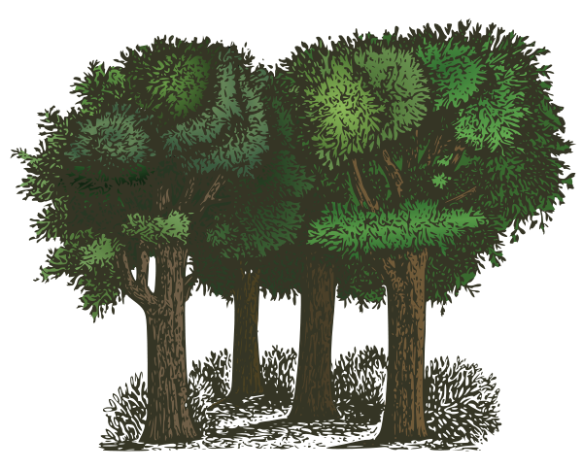
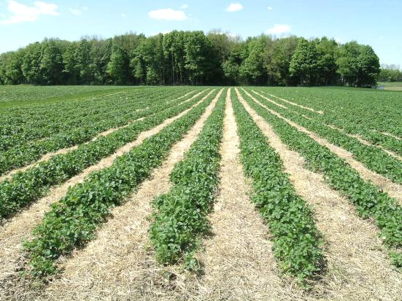
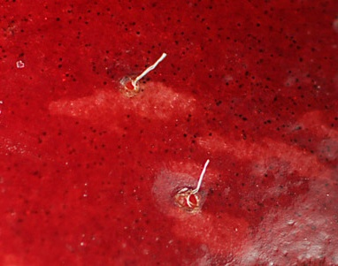
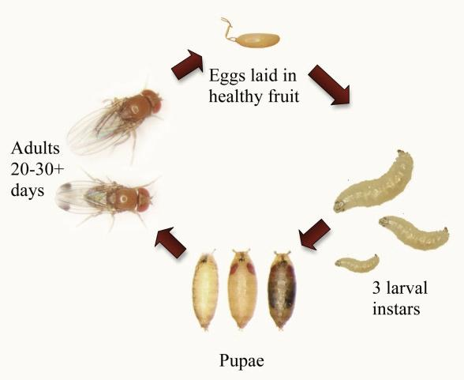
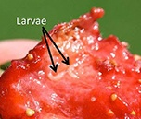
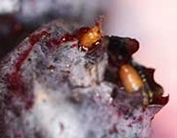
SWD Life Cycle
One female can lay 350+ eggs
Adults overwinter – wooded field edge
12-72 hours
20-30+ days
5-7 days
4-15 days
Notes:
Adults overwinter under leaf litter of wooded field edge.
When air temperatures exceed 45F, adults can become active.
(Not certain what the cold threshold is for adult survival, but survives well in Asia during cold winters)
Adults fly into fields and lay eggs in newly set fruit (it’s hard, but serrated ovipositor can saw through)
A single female can lay hundreds of eggs in her lifetime.
Eggs hatch in as little as half a day; larvae develop through 3 instars reaching pupation in as little as 15 days.
A new generation can start in as little as 3 weeks.
Populations build up quickly.
Early ripening crops fair well
Mid-summer crops like blueberries will be infested if fields are not treated.
Late developing crops suffer the most (when populations are at the highest)

Slide 5
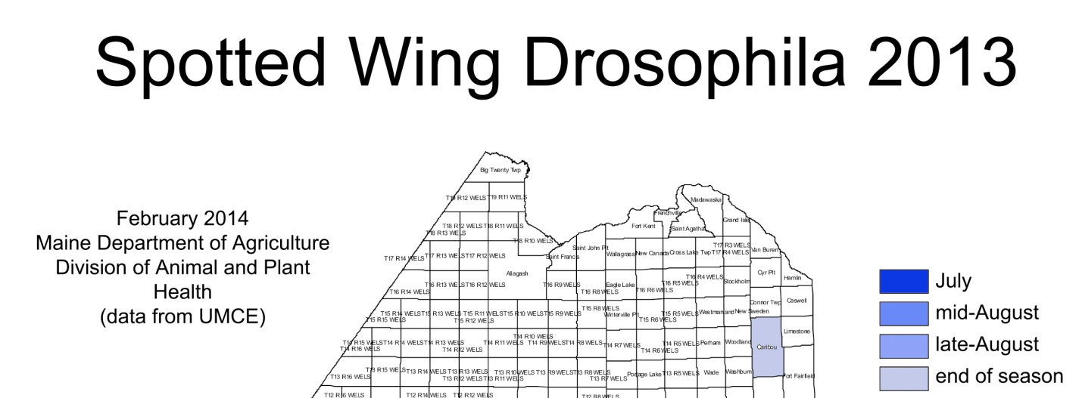
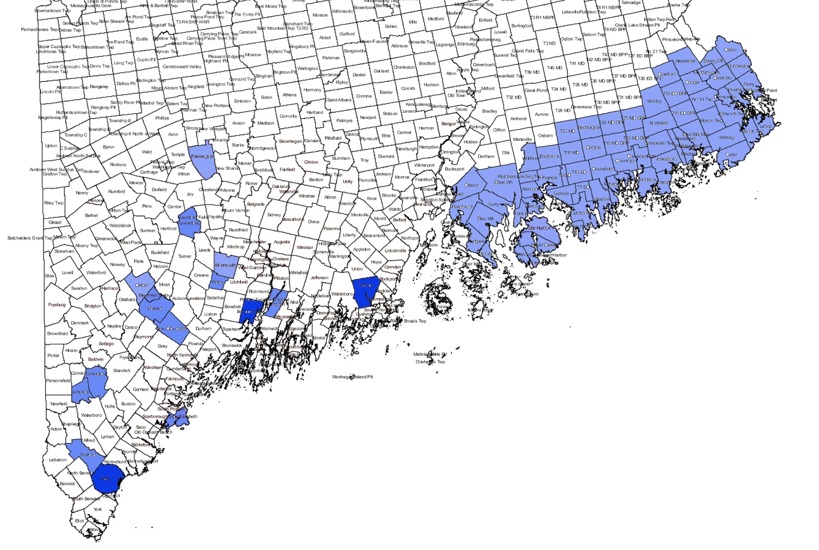
Maine, 2011
Fall raspberries
2013
Trapped berry fields - southern, central, coastal Maine
First SWD, July 19 (Warren)
Catch counts fairly low until September
Highest numbers in southern and coastal sites
SWD caught until late November
Caribou – 3 SWD caught
Notes:
SWD was discovered in Maine in 2011 infesting fall raspberries.
This map shows where cooperative extension has been tracking its spread and numbers since.
They find that SWD numbers build over time;
In 2013, the first SWD were caught in Warren and Wells on July 19. Very few or no flies were caught in other traps until the 3rd week of August.
Low numbers were caught at all locations by end of Augusta: Limington, Limerick, Springvale, Cape Elizabeth, New Gloucester, Poland Spring, Mechanic Falls, Wales, Livermore, Bowdoinham, Dresden, Hancock and Washington Cos. (blueberry fields), Monmouth, Farmington, Oxford.
By September, some locations had 1000s of flies per trap.
By October, most traps had 1000s of flies.
Caribou trap caught 3 SWD

Slide 6
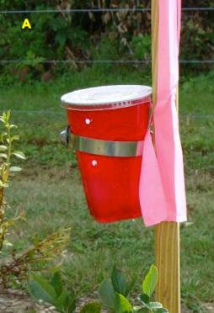
Six Rules for Managing Spotted Wing Drosophila:
Monitor for the flies with traps, and for the larvae in fruit.
Spray regularly and often once flies have been found in the field (1-2/week).
Harvest fruit regularly and often; do not leave any ripe/rotten fruit in the field.
Sort fruit at harvest; do not leave any soft fruit in the container to be sold.
Chill all fruit immediately after harvest to 38ºF (or as close as you can) for at least 12 hours to slow development of any eggs or larvae.
Prune the planting to open up the canopy and create dry, light conditions.
University of Maine Cooperative Extension
http://umaine.edu/highmoor/news-events/
Notes:
Growers found that twice weekly sprays were needed to keep larvae out of field.
Entrust, Delegate, Brigade, Bifenthrin, Hero, Mustang Maxx, and malathion, offered adequate control if applied frequently.
Keep checking Cooperative Extension’s page for management options.

Slide 7
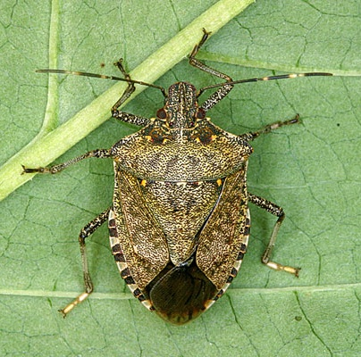
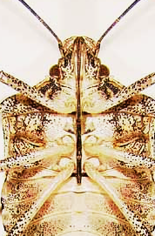
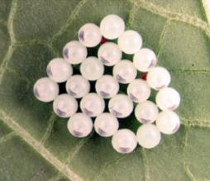
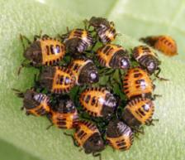
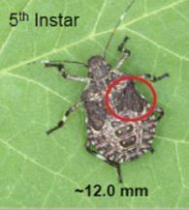
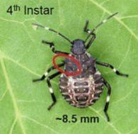
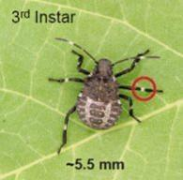
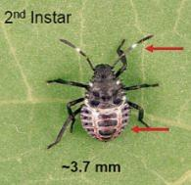
Brown Marmorated Stink Bug (BMSB)
Halyomorpha halys
Eggs laid on undersides of leaves
D. Shetlar, OSU
A “true bug” – piercing/sucking mouthparts
5 nymphal stages
Photos: Rutgers Cooperative Extension
njaes.rutgers.edu
1 generation/year in northeast
adults overwinter (in buildings) and live 6-8 months
Notes:
Order hemiptera – the true bugs
Has piercing sucking mouthparts
Adults are a mottled brown and ~1/2” long; they can live 6-8 months
Likely only one generation in the northeast
adults mate in the spring approximately two weeks after emerging from diapause or the resting phase. After a short period, the females begin laying egg masses. Egg masses are laid at approximately weekly intervals, and each female lays as many as 400 eggs in her lifetime. In Pennsylvania, females were observed laying eggs from June to September

Slide 8
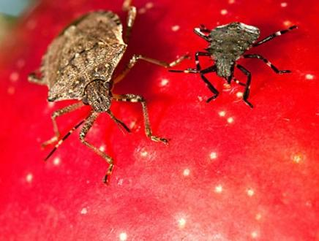
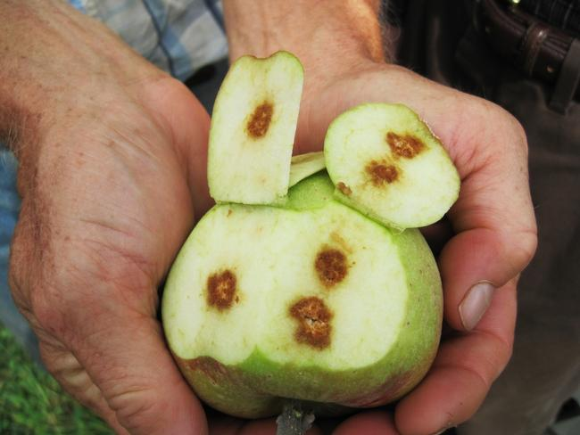
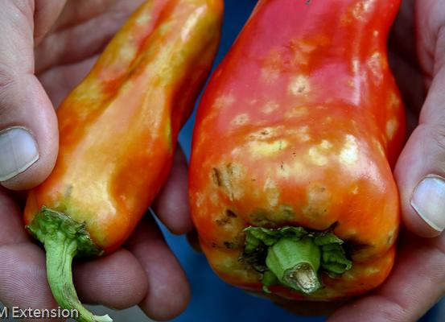
What does it do?
Attacks a wide variety of fruits, vegetables, ornamentals and legumes
  over 100 host plants documented
  stone fruits, apples, tomatoes, peppers, corn, soybeans, roses, crabapple…
  adults and nymphs – pierce the fruit; suck out nutrients
Stephen Ausmus
Chris Bergh, Virginia Tech
UMD Extension
Notes:
BMSB has a very large host range
Small necrotic spots on fruit and leaf surfaces often result from feeding damage, and it may be compounded by secondary infections and scarring as the fruit matures. In particular, affected apples often exhibit pitting and
discoloration symptoms and peaches frequently display a characteristic distortion referred to as "catfacing" (Hamilton and Shearer 2003). Even if a fruit such as a peach is still edible, it may not be suitable for market. Similar damage to other crops, such as soybeans, is more likely to occur in the southern US. The BMSB is also known to vector or spread a plant disease that is important to at least one tree crop in Asia (Hiruki 1999). Because the BMSB is polyphagous, or feeding on a wide range of host plants, almost any crop with fruit may be at risk.

Slide 9
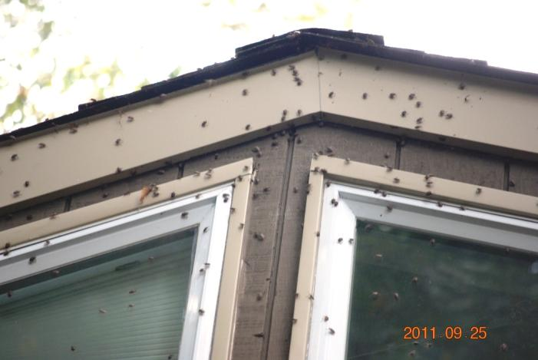
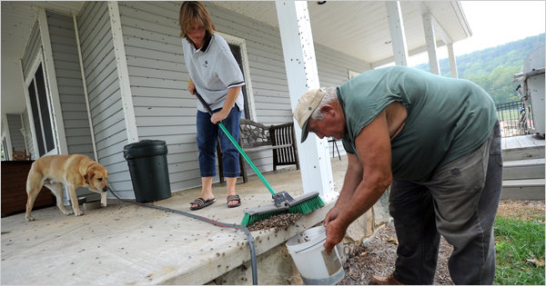
BMSB is a home invader
  overwinters in buildings/homes
  emits stinky odor
Steve Ruark,The New York Times
Notes:
Can be quite a nuisance as adults accumulate on sides of buildings and work their way into homes
The brown marmorated stink bug is an agricultural pest of fruit crops and soybeans in Asia. They are also a household nuisance pest in Japan and exhibit the same overwintering behavior that they do in the United States.

Slide 10
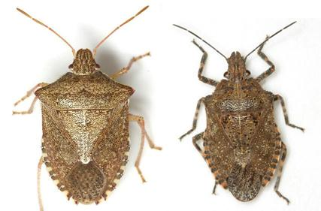
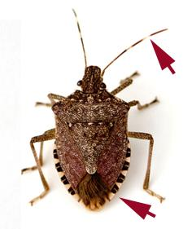

Recognizing BMSB
Mike Quinn, TexasEnto.net
Melinda Fawver
Brown stink bug (Euschistus servus)
Bark stink bug (Brochymena quadripustulata)
Brown marmorated stink bug (Halyomorpha halys)
BMSB has:
  black and white pattern around abdomen
  white bands on dark antennae
  smooth pronotum
Notes:
The brown marmorated stink bug (Halyomorpha halys, right) can be distinguished from the brown (Euschistus servus, left) and bark (Brochymena quadripustulata, center) stink bugs by markings and the white bands at the joints of the antennae.

Slide 11
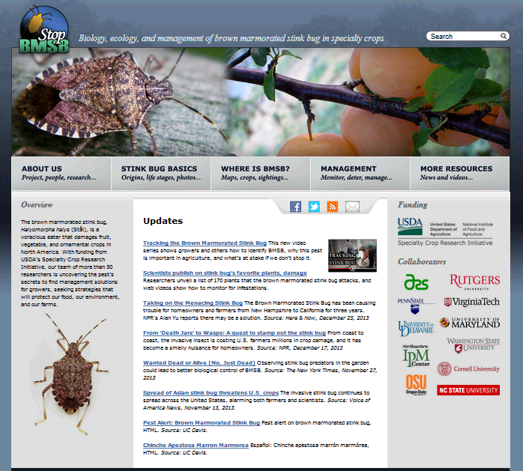
What Can You Do
Learn about BMSB
www.stopbmsb.org
Report suspicious sightings
BMSB is a home invader pest first
Notes:
BMSB has not been reported in Maine as a nuisance pest or agricultural pest… yet.
Populations are starting to build MA.
Report nuisance sightings. That will be a beacon to growers and farmers

Slide 12
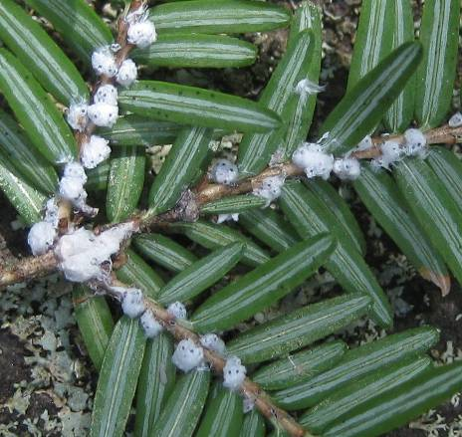
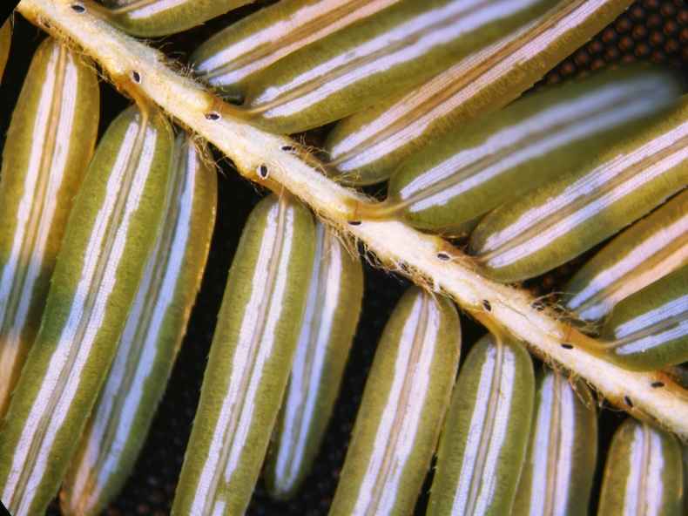

Hemlock Woolly Adelgid (HWA)
Adelges tsugae
Host = hemlocks
  (different adelgids on other conifers)
Causes decline/mortality of hemlocks
Attached to twig at base of needle
Key to detection: white waxy masses attached to twigs
Wool most visible December through June
Can be hard to see from July through October
crawlers are invisible
Notes:
Hemlock woolly adelgid was detected in Maine’s hemlock forests in 2003. It is an invasive insect native to Asia and the Pacific Northwest that attacks hemlocks and can cause decline and mortality of native hemlock. The insect attaches along the twigs, at the base of hemlock needles on newer growth. The most easily recognized sign is the white waxy material (“wool”) that covers the insect as it develops. This is most visible from December through June. Two stages of the insect are nearly invisible—the crawlers, which are mobile and hatch out of eggs in the spring are miniscule, can be picked up on clothing and equipment. The settled nymphs of the overwintering generation spend up to 4 months without the woolly covering, and can only be seen with magnification.

Slide 13
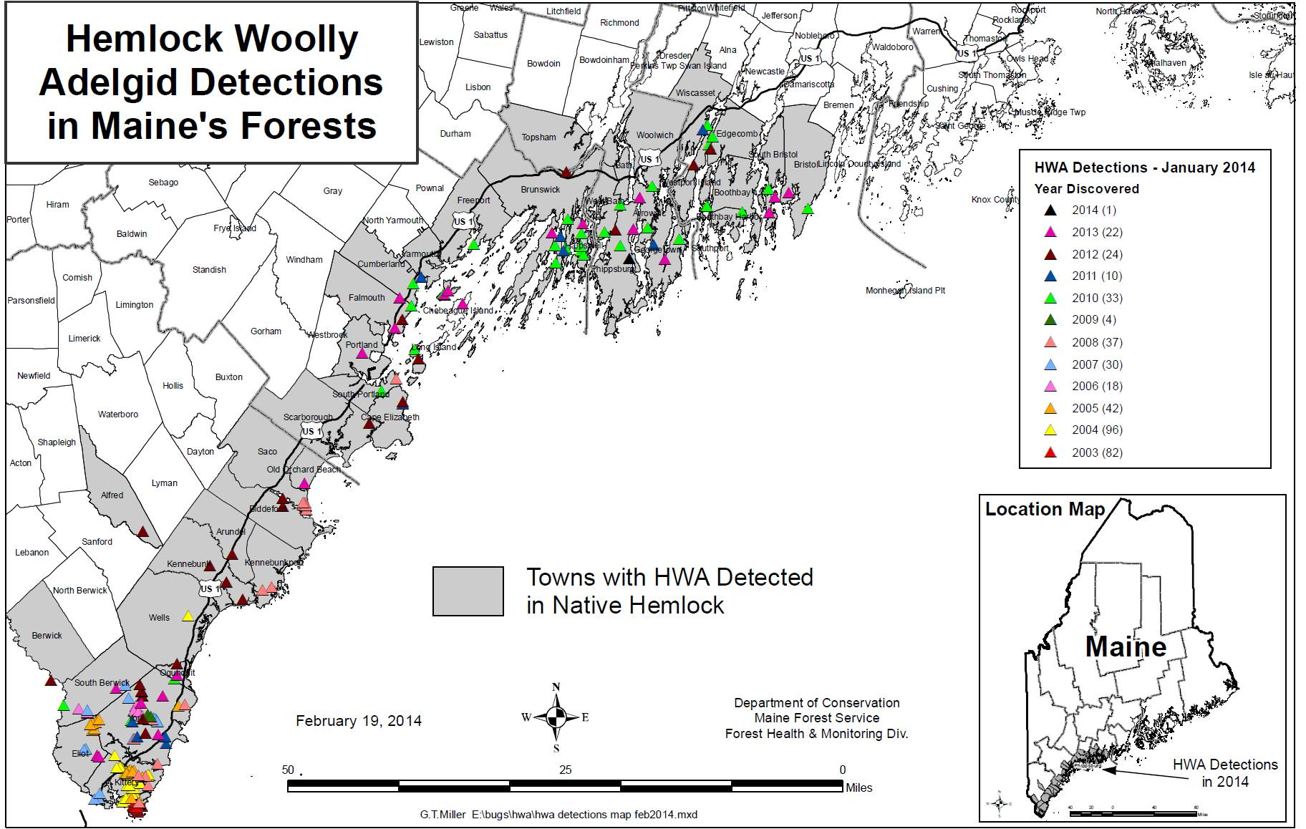
Please report detections!
www.maine.gov/forestpests
Notes:
In the forest, this insect has been found to the eastern border of Lincoln County. It has been found in plantings all the way east to Lubec and North to Bangor, with infested plantings most recently detected in Coastal hancock county (MDI, Ellsworth, Sedgwick).

Slide 14
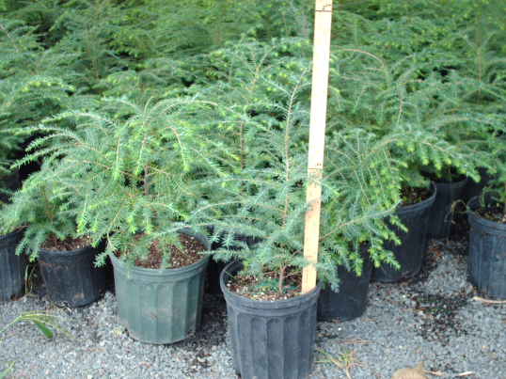
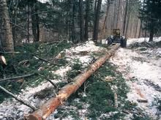






How do WE move them?
Year Round - live plants
March-July (crawlers/eggs)
  Severed hemlock
  Clothing, Machinery, etc.
What about natural spread?
March-July (crawlers/eggs)
  Wind and weather
  Animals
Notes:
HWA spends a lot of the year attached to its host—and unless it is an egg or a crawler, cannot survive off of the host plant. People move HWA by moving infested, rooted plants, by moving cut hemlock when the eggs and crawlers are present (roughly March through July), or by moving eggs and crawlers on equipment, clothing or other items.
HWA spreads naturally when eggs or crawlers are picked up by wind and weather or by animals such as birds and small mammals.

Slide 15



HWA Management
Physical/Cultural :
Prune at-risk material/infested material (August-Mar)
Isolate from yard care /
other delivery / maintenance
(consider mulch)
Replacement
Biocontrol: Forest
Regulatory: Quarantine (rooted plants, top material)
Chemical:
Oil/Soap -- foliar
Neonicitinoid systemic –soil / basal bark / trunk
Combination
Notes:
An integrated approach to HWA management may include
physical and cultural approaches
such as pruning material that might be encountered by carriers (think delivery vehicles, hikers and others),
isolating hemlock branches from maintenance activities such as lawn care (consider mulch as underplantings may interfere with eventual management with soil-applied systemics), and
replacement with alternative species.
Biocontrol in more natural settings
Regulatory control on carriers of the pest such as rooted plants and top material as well as
Chemical management of the pest.
Chemical management likely necessary to maintain function in landscapes
Oils/Soaps quite effective if full coverage possible—often annual applications required
Neonicitinoid systemics also very good at managing adelgid—various application methods, can achieve several years of acceptable level of control
A combination of the two can also help with immediate control/management of pests such as spider mites or scale.

Slide 16






Winter Moth(WM)
Operophtera brumata
Eggs: Dec - Apr
Gyorgy Csoka, Hungary Forest Research Institute, Bugwood.org
Waltham Services
Tom Murray, BugGuide.net
Adults: Nov - Jan
Maine Forest Service
Hannes Lemme, Bugwood.org
Cape Cod Times/Steve Heaslip
Pupae: Jun - Nov
Larvae: Apr - Jun
Notes:
Eggs hatch in early spring at or just before bud break. The larvae, which are greenish inchworms or loopers, then crawl up the tree and enter leaf and flower buds to feed. The larvae may also balloon, which is spin a silken thread that carries them on the wind to new areas to cause new infestations.
In Late May to Early June the larvae spin down out of the trees and enter the soil to pupate, they then remain in the soil until November when the adults emerge.
The adults are active until January when the temperatures are above freezing. The females are wingless and lay eggs on bark and other surfaces, but the males can fly and are often attracted to outdoor lights. The adults look very similar to the native Bruce Spanworm which has a similar flight period and you can usually only tell them apart by sending a sample to the lab.

Slide 17



What does WM do?
Larvae feed in early spring
On newly forming buds
Then free-feed on expanded foliage
Causes “swiss cheese” effect
Defoliate hardwood trees and shrubs
89,000 acres in 2011 (MA)
Extensive oak mortality
Problems seen in highbush blueberries, cranberries, apple orchards…
Favored hosts:
oak
apple
maple
birch
basswood
blueberry
cherry
P. Johnson
Back Bay Garden Club
Maine Forest Service
Notes:
Larvae feed on buds of deciduous trees in early spring. Leaves emerge with holes already in them
Extensive defoliation in Massachusetts – many oak trees have died through continuous defoliation

Slide 18


Risk of Spread
WM is in the soil from June - November!
Coccoons look like dirt
WM is on host plants from November - June
Host plants and soil from infested areas are potential carriers
Notes:
High risk of spreading insect in soil from June through adult emergence!
From egg deposition through pupation, high risk of spreading insect on host plants.

Slide 19

Notes:
This map predicts risk for winter moth (Operophtera brumata)- caused defoliation in spring 2014. Estimates of risk are based on locations with mapped defoliation in 2013, moth flight reports from our on-line survey in December and other customer calls, moth samples submitted by the public and in pheromone traps set by the Maine Forest Service in December 2013. The risk level was also adjusted to reflect the weather-related very brief adult emergence period that occurred in 2013-14.
Risk of defoliation is lower this year because cold December shut down moth emergence/survival which should have limited mating success and oviposition.

Slide 20



WM Management Options
Monitor
  Adults - November to January – tree banding or pheromone traps
  Larvae – April - visual
Dormant oil sprays – overwintering eggs
Bacillus thuringensis kurstaki
  Works best on young larvae, but not effective if larvae are feeding inside buds
Other sprays – spinosad, tebufenozide, insecticidal soap, carbaryl, malathion, pyrethroids
Biological control
  Parasitic fly – Cyzenis albicans
  Successful control in Nova Scotia
  Also in British Columbia and now in Massachusetts
Eggs are laid on surface of host leaves
Notes:
There is a proven biocontrol that may bring things in balance in the forest. It is a parasitic fly that lays its eggs on chewed leaves. Eggs consumed by winter moth larvae can develop within the pupating moth. Very host specific. Used successfully in Nova Scotia (introduced >45 years ago) and has been introduced more recently in BC and Ma.

Slide 21



White Pine Blister Rust (WPBR)
Cronartium ribicola
Disease of 5-needle pine and Ribes spp.
Notes:
White pine blister rust is an invasive disease that affects 5 needled pines including our state tree, the eastern white pine. It has a complicated life cycle, with 5 spore stages that alternate between two hosts: the aforementioned 5-needled pines and Ribes (currants, gooseberries, jostaberries). The fungus, Cronartium ribicola, sporulates prolifically on the non-native European black currant. Possession and planting of European black currant and its cultivars is illegal in all of Maine.

Slide 22


On Ribes: Severity Ratings (%): 1, 5, 12
25, 50, 75
Notes:
Recently, it has been confirmed that a new strain of the pathogen now able to infect previously resistant or immune species and cultivars of Ribes. The USDA Forest Service has worked with State of NH to identify sites with permitted Ribes plantings, and has evaluated severity of disease on those plantings.

Slide 23

Notes:
Immune and resistant varieties of Ribes were both susceptible to infections by WPBR fungus. The immune more so because immunity from a single gene (resistance from multiple).

Slide 24

Quarantine
Currants and Gooseberries
Planting of plants in genus Ribes (currants and gooseberries) prohibited on town-by-town basis
The planting or possession of European black currant, Ribes nigrum or its varieties anywhere within the boundaries of the State of Maine is prohibited.
http://www.maine.gov/dacf/mfs/forest_health/diseases/white_pine_blister_rust_rule.htm
Notes:
WPBR quarantine:
Planting or possession of European black currant – Ribes nigrum - is prohibited throughout the state;
Other Ribes sp. are restricted only in the towns shaded purple.

Slide 25


Impatiens Downy Mildew (IDM)
Plasmopara obduscens
Caused by fungus Plasmopara obduscens
  not the same pathogen that causes downy mildew on other crops
Only infects Impatiens walleriana & Impatiens balsamina
  May also infect jewelweeds
Spread by:
  Infected plant material
  Spores that blow long distances in the wind or that splash from plant to plant
  Produces resting spores that may overwinter in the soil
Notes:
Impatiens downy mildew is not a totally new disease to the US (it may have been found here as early as the late 1800s), but it wasn’t until 2004 that significant, but still sporadic outbreaks, of this disease showed up. The 2011/2012 growing season saw significant widespread losses in landscape plantings of impatiens. This lead to dire predictions about disease outbreaks in 2013 and questioned the future of impatiens in the US landscape.
Impatiens downy mildew is caused by a fungus, but it is not the same pathogen that causes downy mildews on other crops, such as basil and cucurbits, it only infects Impatiens walleriana, the common garden impatiens and Impatiens balsamina, garden balsam, it may also infect some jewelweeds. It does NOT infect New Guinea impatiens.
Infection is usually spread by infected plant material (that may take sometime to express symptoms), spores that are blown long distances on the wind or splashed from nearby plants. It also produces resting spores in infected plant material that help the fungus survive the winter.

Slide 26


IDM Symptoms
Yellowing, downward curling foliage
White fluffy growth on underside of leaf
Defoliation
Notes:
Symptoms you might notice may look like nutritional issues, spray injury or cold damage. Yellowing, light green or gray markings on upper surfaces of leaves with some downward curling foliage.
On closer examination the underside of leaves will have white fluffy growth. Keep in mind that there can be a latent period of 5 to 14 days depending on weather conditions, when a plant is infected, but the white sporulation under the leaves hasn’t developed yet, or the sporulation can be quite light
As the infection progresses severe defoliation occurs, making the plants look like a collection of sticks with maybe just a few small leaves attached and eventually the plant collapses and dies.
Plants that are infected early on in development may also be stunted in height and leaf size and the flower buds can be malformed.

Slide 27

IDM Recent History
Grower response to threat
  Most grew fewer impatiens,
  Customer education
Most common replacements
  New Guinea impatiens, begonia, torenia, coleus
Reports of IDM in Maine 2013
  4 in August & September (Bath, Bangor, Portland, Orono)
  No symptoms observed at greenhouses
Why fewer reports of IDM?
  Fewer impatiens grown
  More preventative measures
  Possibly unfavorable weather conditions
Notes:
So what actually happened in 2013?
We observed that most growers grew fewer impatiens or eliminated impatiens all together from their spring crop. A few growers chose to grow as many impatiens as usual. No matter what the approach growers took on how many impatiens to grow nearly all greenhouses tried to educate their customers either through, signs, factsheets or conversations with customers.
The most common replacement plants we observed in person and in trade publications were New Guinea impatiens, various types of begonia, torenia, coleus and caladium.
So were the dire predictions true? No. In general according to trade publications and reports from other states, while there were some reports of impatiens downy mildew this year, there were fewer reports then in 2012. In Maine there were 4 kind of “official” observations from master gardeners and extension folks that were asked to look for impatiens downy mildew this year and they were all in August or September. Carole and I also kept our eyes open this spring and summer while we were conducting inspections at businesses selling plants and we did not observe any symptoms.
Was the impatiens downy mildew much ado about nothing, why were there fewer reports in 2013? Some possibilities are that there were simply fewer impatiens grown in 2013, fewer plant means fewer hosts and also means fewer infected plants which means less inoculum to infect other plants. It could also be that there were more preventative measures taken on the plants that were grown. Growers were much more aware they might have a problem and took preventative action through, scouting, treatment and rogueing reducing the number of infected plants sold. And one report I read speculated that there may have been weather conditions in the spring in some parts of the country that made the environment less favorable for disease development.

Slide 28

IDM Future
Impatiens downy mildew is still here
Continue to use caution when deciding what to grow for impatiens next season
If you do grow impatiens continue to:
  use preventative measures,
  scout your crop,
  take action if symptoms are observed
www.maine.gov/dacf/php/horticulture/growerresources.shtml
Notes:
So what’s the outlook in 2014 and how should you manage your impatiens crop in the future?
The bottom line is that impatiens downy mildew is still here and will probably continue to pose a threat into the future. You want to still use caution when deciding what impatiens to grow next season.
And if you are growing impatiens continue to:
Use preventative measures, including preventative sprays to protect your crop
Scout your crop regularly so that you identify any problems early
And if you see symptoms, take action to prevent disease spread to the rest of your crop
Questions on impatiens downy mildew?

Slide 29

Invasive Plants
~ 2,100 plant species recorded from Maine
~ 1/3 of those are not native
A small fraction of those are considered invasive
These have the potential to cause great harm to our landscape
Increase the costs of agriculture
Affect forest regeneration
Threaten our recreational experiences
Decrease property values
Outcompetes native species
Change animal habitat by eliminating native foods, altering cover, and destroying nesting opportunities.
Aquatic invasives can choke waterways, making it difficult to boat or swim.
Notes:
Next we are going to move to another category of invasive pests… plants.
Approximately 2100 species of plants known in Maine
About 1/3, or 700, of those are not native
A small fraction of those are considered invasive
Remember, definition of invasive species is an organism not from an area that causes economic or environmental or health harm.
There are four categories of control methods for invasive plants. I want to give an overview of these before talking about the individual species, so that I can then mention the best control method for each as we cover them.

Slide 30

Herbaceous Plant Control
Act before seed set and senescence
Dead head
Dispose of properly – don’t compost!
Remove entire plants with all roots
Notes:
There are four categories of control methods for invasive plants. I want to give an overview of these before talking about the individual species, so that I can then mention the best control method for each as we cover them; Manual, Mechanical, Chemical, Biological.
With herbaceous plant control it’s important to remember these plants do not have woody stems and therefore it may be easier to manually or mechanically control by pulling the plants. Often with the herbaceous species the dispersal of seed is a main pathway for dispersal, so if you can control the plant before it goes to seed you can prevent that type of dispersal. Deadheading can an effective way to do this before the seed is dispersed.
It is also very important to dispose of the plants properly in order to be sure that they don’t start growing somewhere else such as a compost pile. For herbaceous perennials that come back every year, it is especially important when hand pulling, to try to get all the roots as often plants can regrow from small root fragments.

Slide 31


Woody Plant Control
Mechanical
  Repeated cutting
  Remove all roots
  Careful disposal
  Repair disturbed area
  Weed wrench
Chemical
  Read label carefully
  Glyphosate (Roundup) or Trichlopyr (Garlon)
  Prevents resprouting
  Often most cost effective
Notes:
With woody plants, it often is not as easy to pull plants out of the ground so mechanical or chemical controls are often needed. Repeated cutting or pulling can help control these plants, but often other techniques need to be used due to suckering from cut stumps, or some plants can regrow from fragments or roots. A weed wrench can help pull woody plants from the ground.
Chemical control is another method for managing invasive plants, especially woodies. It is important to always read and follow label directions carefully. Two commonly used chemical herbacides are glyphosate (Roundup) and Trichlopyr (Garlon). Application methods can be cut stump treatment, basal bark treatment, foliar spray or soil applications. Herbacides help prevent the resprouting that occurs when plants are cut back, because they kill the root system too. Therefore chemical controls are often the most cost effective method, as time spent is reduced.

Slide 32


Oriental Bittersweet
Celastrus orbiculatus
Notes:
Oriental bittersweet or Asiatic bittersweet (Celastrus orbiculatus).
Habit:
-Woody vine can grow 10 ft/ year
-twining and climbing up and over other plants can smother natives, weigh down branches, girdle trees as can be seen in these pictures
-Multiple habitats (FP, shrubland, rocky areas, forest edge, disturbed forest)
Documented in at least 5 counties

Slide 33



Oriental Bittersweet
Identification
  Bright orange/red fruit borne along the stems
  Alternate leaves (yellow in fall)
  Roots are bright orange
Spread
  Large # of seeds
  Bird dispersed
  Suckers and fragments
Management
  Cut stump treatment
Notes:
Identification:
Introduced as ornamental for fruit- as you can see it has incredible bright orange/red fruit. These are originally green and borne along the stems, and once the leaves fall off, stems with orange fruit have been known to be used in holiday decorations. This of course helps spread the seeds, so we don’t recommend that it be used in that way anymore.
Leaves: Leaf shape mostly round with a pointed apex, but can become long and narrow (attenuate). Crenate(rounded) serrations on margin -turn yellow in fall
Roots: also bright orange
Spread:
-large number of seeds are produced and are dispersed by birds/animals
-Easily pollinated by insects and wind
-Large seed bank
-Suckers and can root from fragments
Management:
Cut stump treatment – paint cut stems with herbicide (either Trichlopyr or Glyphosate)
Small patches can be handpulled – try to remove entire root to prevent resprouting

Slide 34


NATIVE Look-A-Like
American bittersweet (Celastrus scandens)
Terminal Inflorescence (fewer seeds)
Notes:
Native Look-alike: Celastrus scandens
Can decipher from oriental bittersweet because it has a terminal inflorescence (flowers at the end). Fewer inflorescences means fewer seeds.
Native only been found in dry woodland hillsides in southwestern Maine plus a record in Skowhegan

Slide 35

Buckthorns
Frangula alnus, Rhamnus cathartica
Notes:
Glossy buckthorn (Frangula alnus)
Woody, deciduous shrubs
Habit:
-can grow 30’ tall
-invades moist woodlands and forested wetlands, disturbed areas, riparian areas
-a little wetter and a little less shade sites, more acidic soils
-rapid growth and prolific seed production
-can shade and displace native shrubs, seedlings, herbs
Emodin a chemical compound released by buckthorn (in leaves, stems, etc.) has a laxative effect so animals poop it out before the sugars can be digested and benefit the animal.
Notable: In Chicago area researchers found that emodin, is toxic to amphibians. Early leaf out means early release, just at time of amphibian breeding. Hatching rates were low in buckthorn infested areas. Also found carnivore densities were higher, they hypothesized that this was due to more birds building nests in buckthorn and targeted by carnivores. Invasive plants really can shift the balance in the whole ecosystem.
-Buckthorn can increase the amount of nitrogen in the soil and therefore impact species composition

Slide 36

Glossy Buckthorn (Frangula alnus)
Identification
  Alternate leaves
  No spines on stems
  Flowers and fruit occur at the same time
Spread
  Prolific fruit- seeds dispersed by birds/animals
  Fruit floats for 9-16 days
  Rapid growth
Management
  Weed wrench
  Cut stump treatment
Notes:
Identification:
Leaves:
-Dark green and shiny
-alternate, sometimes opposite
-prominent venation
-entire leaf margin – no serration
Fruit/flowers:
-inconspicuous flowers, pale yellow, in axils, in spring
-fleshy fruit starts red and matures to dark purple/black
Spread:
-seeds have a laxative effect (from emodin) on birds and small mammals – quick dispersal.
-Fruit can float on the water for 6-19 days, so flooding can help disperse too.
-Plants grow rapidly
Management:
-Repeated cutting or weed wrench.
-Cut stump treatment.

Slide 37


Common Buckthorn (Rhamnus cathartica)
Differences from Glossy Buckthorn
  Leaves nearly opposite; edged with small teeth
  Semi-sharp spine on twigs
  Inner bark is orange
  Fruit ripens later
  Seeds viable for 2 years
  More shade tolerant
Notes:
Common buckthorn (Rhamnus cathartica)
Habit:
-can grow 25’ tall
-well drained soils, neutral to basic soils, riparian forests and floodplains, more shade tolerant
Leaves:
-Dark green, somewhat folded tip
-small teeth along margin
-usually subopposite
Stem: inner bark is orange, twigs usually tipped with a semi-sharp spine
Fruit/flowers:
-yellow-green, 4-petals, at base of leaves
-small black berries
Reproduction: seeds have a laxative effect (from emodin) on birds and small mammals – quick dispersal.
-Fruit can float on the water for 6-19 days, so flooding can help disperse too.
-ripen later than glossy buckthorn and last on plant longer
Notable
Seeds germinate well in the shade
Seeds remain viable for at least 2 years

Slide 38

Japanese Knotweed
Fallopia japonica
Notes:
Japanese knotweed (Fallopia japonica) aka, Mexican bamboo
Herbaceous perennial
Forms dense thickets
Colonizes riparian areas
Habit:
Tends to completely take over areas with lots of stems coming out of ground so dense it is impenetrable.
Dies back to ground every year.
Can tolerate full shade, high temps, high salinity, and drought, so it is very versatile.
Found near water, low lying areas, ROW, waste areas, roadsides. Thrives in moist, open to partially shaded habitats and poses a significant threat to riparian areas where it can survive severe floods.

Slide 39



Japanese Knotweed
Identification
  3 to 10 feet tall
  Round hollow stem
  Fruit - papery and winged
Spread
  Reproduces via rhizomes
Management
  Solid mulch
  Mowing
  Goats
  Need to continuously
  control
Notes:
Identification:
Leaves: up to 6” long, 3-4 wide, rounded and heart shaped.
Stem: membranous sheath at each joint along the stem (typical of Family), swollen at joint, hollow
Fruit/flowers:
Greenish white flowers that grow in linear clusters along the stem
small winged fruits
Reproduction:
-primarily reproduce by vegetative growth but can reproduce by seed (>100,000 seeds/stem if all pollinated and set seed) but few germinate and survive
-rhizomes can be 45-60 feet long and roots can go 6 feet deep (which is why its difficult to control manually) – need to deplete its energy resources in that large root/rhizome system or will continue to spread.
Control:
Should be removed as soon as it is found
If well established, repeatedly cut the stalks; 3 or more cuttings in a growing season can offset growth of the rhizomes
Can smother with a solid mulch (black plastic)
Or, cut it down repeatedly, apply glyphosate
Notable:
Can be transported as discarded cuttings, contaminant in topsoil, even via water in springtime flooding – seen in many places within floodplains along rivers. Small pieces can create a new population.
-Was planted to surround outhouses and provide cover!

Slide 40

Garlic Mustard
Alliaria petiolata
Notes:
Garlic mustard (Alliaria petiolata)
Herbaceous biennial
Habit:
-Forest invader
-can grow almost anywhere, but most aggressive in rich, moist, shady locations (cannot tolerate highly acidic soils)
-can grow in forests, field edges, roadsides, along trails, and in disturbed areas.
-Highly shade tolerant which makes it a strong competitor against native vegetation.
Notable: brought to the US during colonial times as an early spring edible; thought to be allelopathic and suppresses mycorrhizal fungi that most plants including native trees need for optimum growth; On the bright side it apparently makes really good pesto.
-Deer study: remove deer and natives come back and able to get edge back over garlic mustard

Slide 41



Garlic Mustard
Identification
  Strong garlic odor
  Heart shaped leaves
  4 parted white flower (crucifer)
  Plants dieback in June
Spread
  Exclusively by seed
Management
  Hand pulling
  Herbicide
  Possible biocontrol
Notes:
Leaves: heart shaped toothed leaves (older plants)
Stem: purple in young plants
Fruit/flowers: biennial; Flower in May, white 4-parted flowers.
Reproduction: exclusively by seed, prolific seeder. Each plant produces can produce thousands of seeds, which are viable for 4-7 years. Although relatively few germinate. Seeds cast by mature plants in late June and they lie dormant for 18-20 months. Seedlings emerge in spring and become basal rosettes in the fall. Rosettes stay green through winter and as a second year plant produce a flower stalk the following spring.
Spread: exclusively by seed – dispersed along trails and waterways by human activities and in the fur of animals (mice, deer, horses)
Control:
Hand pull plants early in the season – remove as much root mass as possible
Cut flower stems close to the ground before seed formation, but high chance of resprouting
Glyphosate-based herbicide can be applied any time of the year, above 50 degrees F
Possible biocontrol – 4 weevil species are being tested

Slide 42

Multiflora Rose
Rosa multiflora
Notes:
Multiflora rose (Rosa multiflora)
-woody shrub, perennial
-aggressive colonizer of open, unplowed land -highly successful on forest edges and forest understory
-With thorny arching stems
– produce impenetrable thickets; excludes native plants
Thrives in open and overgrowing fields, open woods, dense woods, forest edges, riparian areas;
tolerates wide range of conditions.
not as vigorous in the shade;

Slide 43




Multiflora Rose
Identification
  Alternate leaves with stipules
  Thorns!!!
  Clusters of fragrant white flowers
  ¼” egg shaped rosehips
Spread
  Prolific seed dispersed by birds
  Root Sprout
  Layering
Management
  Rose rosette disease
  Spot treatment with herbicide
Notes:
Leaves: alternate with fringed stipules
Stem: Thorns
Fruit/flowers: fragrant white flowers (blooms June/July) and small rose hips on terminal branches fruits remain on plant through winter
Reproduction: primarily by seed – one plant can carry up to 1 million/year, viable for 20 years in soil; seeds dispersed by birds and humans (primarily)- birds eat the fruit and its still viable after passing through digestive tract;
-perennial can sprout from roots;
-can also reproduce by layering;
Control:
Spot treatment with glyphosate, large fields may be broadcast treated with other types of herbicides

Slide 44

Japanese Barberry
Berberis thunbergii
Notes:
Japanese barberry (Berberis thunbergii)
-Similar to multiflora rose, upward arching stems with spines, but not as tall.
-Takes over forest understory, impenetrable
-Easy to recognize as it is one of the first plats to leaf out in spring
Habit: wetlands, fields, forests; commonly spread along tree lined roadsides where birds roost; thrive in sunlight, tolerant of shade, may flower less if in the shade; can outcompete plants in the understory of woodlands
Notable: barberry infestations can lead to increases in rates of Lyme disease bc ticks like to hang out at the tips of shrubs waiting for mammals and mice live in the thorny stands (alt host for Lyme)

Slide 45




Japanese Barberry
Identification
  Small spatulate leaves
  Sharp spines at leaf base
  Yellow spring flowers
  Red fruits
Spread
  Prolific Seeds
    High germination rate
    Eaten by wildlife
  Root Sprout
  Layering
Management
  Hand pulling isolated plants
  Foliar spray, cut stump, basal bark treatments
Notes:
Leaves: single spine at each leaf base, spatulate shaped leaves, turn red and orange in fall (attractive)
Stem: single sharp spine at each leaf base
Fruit/flowers: red fruits, yellow flowers
Reproduction: mainly by seed (90% germination rate) but can root sprout and layer;
-seeds dispersed by grouse, birds, turkey, small mammals, and seedlings tend to be found under or adjacent to adults
Control:

Slide 46




Next Steps and Opportunities
Act to prevent the spread of invaders while most of our natural systems are still in good condition.
Prevention
Early Detection / Rapid Response
Control, Management, Restoration
Protecting native species
Notes:
The bad news is invasives are here to stay but the good news is there are things that can be done to prevent new plants from arriving and infestations from spreading.
Prevention: Education, outreach, regulation: don’t import invasives, don’t plant them, don’t spread them, and consider the potential for invasives when managing natural areas, planning recreation, etc. EDRR: the best way to control invasives is to get at them when the population is small enough to manage successfully – learn to ID species, monitor, detect, react – for established species and new spp to our area.

Slide 47





Prevention
Public Outreach/Education
Awareness
Best practices (e.g. don’t move plant material – including firewood)
Notes:
Education to school groups, being aware of what you purchase or transplant, public outreach efforts to promote awareness (aquatics example), manage natural areas with the consideration for potential invasives and keeping plants out.

Slide 48


Early Detection / Rapid Response
Keep alert; survey
Collect suspect specimens or take photos
Note location and REPORT

Slide 49


Control, Management & Restoration
Know the species and life cycle
Ask professionals for best management strategies
Don’t give up
Notes:
This is where its important to know what you have, how it invades, how to treat it, and to consider the need for long term monitoring and management. Resources include SWCD, land trusts, MFS, towns. Ongoing process. Choose battles wisely, establish clear goals, and recognize limits. And keep at it!

Slide 50






Positive Spin
Value in these species?
  Food
  Art
Notes:
Japanese knotweed = rhubarb
Garlic mustard pesto
Autumn olive jam
Honeysuckle syrup
Emerald ash borer earrings
Japanese barberry bracelet

Slide 51
Resources
Invasive Forest Pests: www.maine.gov/forestpests
Invasive Agricultural Pests: www.gotpests.org
Invasive Plants:
www.maine.gov/dacf/mnap/features/invasive_plants/invasives.htm
www.gobotany.newenglandwild.org/
www.vtinvasives.org/
www.nps.gov/plants/alien/factmain.htm

