Slide 1
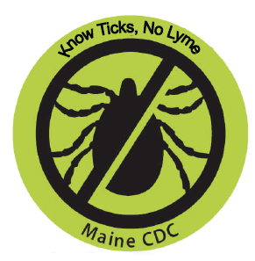
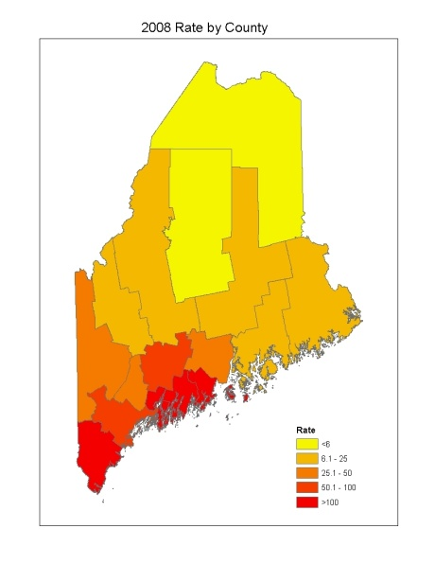
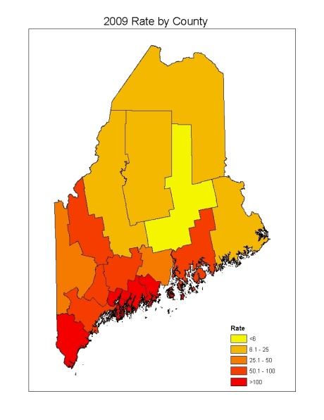
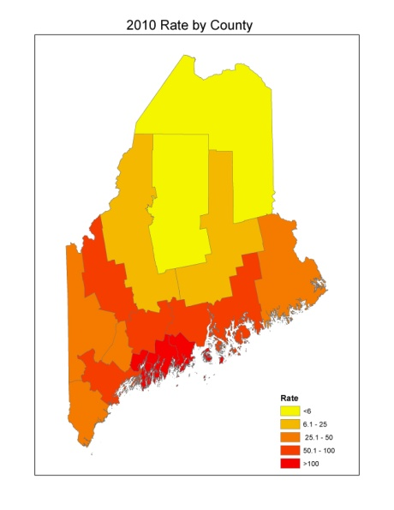
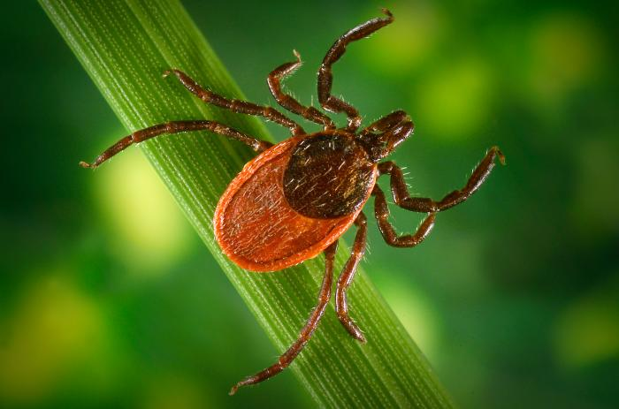
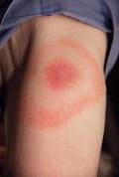
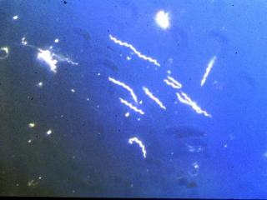
Evaluation of Human Lyme Disease Surveillance in Maine, 2008 – 2010
Megan Saunders^{1,2} MSPH, Sara Robinson² MPH, Anne Sites² MPH MCHES
¹University of Southern Maine
²Maine Center for Disease Control and Prevention
BACKGROUND
EVALUATION RESULTS
Lyme disease is the most commonly reported vector-borne disease in the United States and the third most commonly reported infectious disease in Maine.
Lyme disease is caused by the bacterium Borrelia burgdorferi and is transmitted through the bite of an infected deer tick (Ixodes scapularis). The deer tick is considered endemic throughout Maine, although Lyme disease is still considered an emerging disease in Maine’s northernmost counties.
Lyme disease has a wide range of clinical manifestations, the most common being the presence of erythema migrans (EM), the initial skin lesion that occurs in 70% to 80% of patients nationwide¹. With treatment, many patients will not progress beyond the early phase of Lyme disease; however some may develop systemic disorders related to B. burgdorferi infection. These manifestations (known as late manifestations of Lyme disease) include dermatologic, rheumatologic, neurologic, and cardiac abnormalities. From 2008 to 2010 Maine had a total of 2,657 confirmed and probable cases of Lyme disease with rates approximately six times higher than the United States’ incidence rate.
The human Lyme disease surveillance system evaluation sought to assess the overall usefulness of Maine’s Lyme disease surveillance system, to identify aspects of the system that can be improved, and to determine areas for interventions to reduce Lyme disease related morbidity and mortality in Maine.
Usefulness
System is useful – allows Maine CDC to identify demographic, geographic, and seasonal patterns of Lyme disease distribution
Monitors changes in Lyme disease incidence in Maine
Simplicity
Passive system of case investigation improves simplicity
Provider completes case report form
No follow-up calls by epidemiologist
Multiple reviews of reports reduce simplicity
Flexibility
Absorbed case definition changes
National Electronic Disease Surveillance System (NEDSS) supports multiple data sources
Data Quality
Majority of case report forms completed with enough clinical information to classify the case
Stability
System is stable with 24 hour availability and minimal downtime
Acceptability
Maine CDC: Good
79.7% of case report forms sent out within 5 days
Provider: Fair
Overall return rate of case report forms = 84.7%
Under-reporting of EM
57.1% of investigations took longer than 30 days
Sensitivity
No “gold standard” for true cases in a population
Low sensitivity due to under-reporting of EM
Shows ability to monitor changes over time
Predictive Value Positive (PVP)
Confirmed PVP: 48.2%
Confirmed + Probable PVP: 59.9%
Representativeness
All reports investigated
Shows Northward expansion of cases over time
Case information corresponds with information on the Northward expansion of the vector
Timeliness
Overall Investigation Time: Fair
Average: 122 days, Median: 37 days
42.9% completed in 30 days or less
Maine CDC Initial Response: Good
Average: 4.04 days, Median: 2 days
79.7% of investigations have this step completed in 5 days or less
Figure 1: Lyme disease Rates per 100,000 by County 2008 - 2010
Ixodes scapularis
Borrelia burgdorferi
Erythema migrans
Images: Federal CDC
Maps Created by Sara Robinson
Figure 2: Lyme disease Reporting Process
ELRs
Paper Reports
Marked as Reviewed
Lyme Disease Folder
CONCLUSIONS
Check Spreadsheet
Labs
Maine’s Human Lyme Disease Surveillance System is Useful, Sustainable, and Functions Well
Overall system quality will improve if Maine CDC:
Streamlines the Lyme disease reporting process to avoid duplication of efforts
Spreadsheet removed from reporting process in 2011
Creates a standard operating procedure (SOP) for the surveillance system
Ensures continuity of clerical staff
Data quality will improve if:
Healthcare providers are educated on case report form completion
Maine CDC ensures proper training of clerical staff
Representativeness will improve if:
Exposure information is captured on the case report form
Occupation information field added to case report form
Tick exposure information added to case report form
Predictive Value Positive and Sensitivity will improve if:
Under-reporting of EMs is reduced
Small scale trial of a weekly registry style report form occurred from June through September 2012
Efficacy of trial is currently being evaluated
Yes No
Completed Forms
Research – Submit to VB Epi to determine if it needs to be resent or reclassified
Letter with Case Report Form Sent. Entered on Spreadsheet
METHODS
Report of
EM
Not Returned Returned
This evaluation was conducted using the Centers for Disease Control and Prevention’s 2001 Updated Guidelines for Evaluating Public Health Surveillance Systems². These guidelines identify the essential attributes of a public health surveillance system. Data was obtained from the National Electronic Disease Surveillance System (NEDSS) and included all reports of Lyme disease from 2008 through 2010. Statistical analysis of data was performed using statistical analysis (SAS 9.3) software.
2008 CSTE Case Definition³
Confirmed: A case of EM with a known exposure*, OR a case of EM with laboratory evidence of infection and without a known exposure, OR a case with at least one late manifestation that has laboratory evidence of infection.
Probable: Any other case of physician-diagnosed Lyme disease that has laboratory evidence of infection.
*All counties in Maine are considered endemic for Lyme disease, therefore living in Maine is considered to be an exposure.
Put in File
Match with Lab Report
Needs Follow-Up
Case Classification
Resend;
Document in Spreadsheet
Entered into NEDSS;
Spreadsheet Updated
Clean and De-Duplicate Laboratory Reports; File
REFERENCES
CDC. Signs and Symptoms of Lyme disease. http://www.cdc.gov/lyme/signs_symptoms/index.html
CDC. Updated guidelines for evaluating public health surveillance systems: recommendations from the guidelines working group. MMWR 2001; 50(RR13);1-35. http://www.cdc.gov/mmwr/preview/mmwrhtml/rr5013a1.htm
CDC. 2008 Case Definition: Lyme disease. http://wwwn.cdc.gov/NNDSS/beta/bcasedef.aspx?CondYrID=751&DatePub=1/1/2008

