Slide 1
ImmPact Reports Danielle Hall danielle.hall@maine.gov

Slide 2
Quarterly Reports
Run January 1st, April 1st, July 1st, October 1st (4)
To be used as a trending tool for rate increases or decreases over the past year
Uses ImmPact data run through CDC software
Not to be compared to any other reports
Childhood
24-35 months
Series 4-3-1-3-3-1-4
Immunized as of 2 years old
State Comparison
24-35 month rate from Childhood Report
Compares practice rate, county rate and state rate

Slide 3
Assessment Reports
Adolescent Report
Children 13-18 years of age
3 HepB, 1 Meningococcal, 2 MMR, 2 Varicella, 1 Tdap
Immunized as of the report date (no age cut off)
HPV Report
Females 13-18 years
All 3 doses of HPV
Immunized as of the report date (no age cut off)
A female & male rate is now included in each report for the current quarter, and will take the place of the female only in 2015.

Slide 4
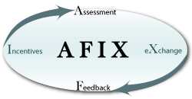
AFIX Reports
AFIX will use the most recent
quarterly reports for both Childhood & Adolescent rates
Summary Report
Diagnostic Childhood Report
Single Antigen Childhood
Missed Opportunities
Invalid Dose
Not up to Date
Notes:
AFIX is a quality improvement program used by awardees to raise immunization coverage levels, reduce missed opportunities to vaccinate, and improve standards of practices at the provider level. The acronym for this four-part dynamic strategy stands for
Assessment of the healthcare provider's vaccination coverage levels and immunization practices.
Feedback of results to the provider along with recommended quality improvement strategies to improve processes, immunization practices, and coverage levels.
Incentives to recognize and reward improved performance.
eXchange of information with providers to follow up on their progress towards quality improvement in immunization services and improvement in immunization coverage levels.
Summary Report:
The purpose of this report is to analyze and report the number and percentage of patients complete and UTD by the assessment date. The number and percentage of patients NOT complete are shown by immunization status. The report also shows how many doses are needed for the patient to be complete and UTD with one additional visit.
Diagnostic Childhood Report:
The purpose of this report is to analyze the total number and percentage of patients complete and UTD based on the report criteria for overall series/antigens along with number and percentage complete and UTD breakdown by doses selected.
Section II evaluates the percentage difference between patients who started on time and completed vs. those who started late and completed by assessment date.
Section III evaluates the drop-off information for DTaP and HepB for patients:
i) 24 months and older who received DTaP 1 and HepB 1 by 6 months of age
ii) 24 months and older who received DTaP 1 and HepB 1 by 6 months of age and received DTaP 4 and HepB 3 by 24 months of age
iii) Patients who didn’t return for immunization for DTaP 4 and HepB 3 by 24 months of age.
Section IV analyzes those patients who missed opportunity to be immunized based on their last immunization visit to be UTD by assessment date.
Section V assesses the accelerated immunization schedule for late immunization starter patients who are not UTD with selected antigens by 12 months of
Single Antigen Childhood:
The purpose of this report is to evaluate the count and percentage of patients who are immunized by age intervals between 3 and 24 months and the dose based on user-selected report criteria. This report does not take being UTD into consideration.
Missed Opportunities:
The purpose of this report is to analyze and list all patients with date of birth, name of vaccine missed, number of dose missed, and vaccination date based on user-selected report criteria.
Invalid Dose:
The purpose of this report is to analyze and list all patients with date of birth, invalid dose, invalid dose date, and a reason why the dose is invalid based on user-selected report criteria.
Not Up To Date:
The purpose of this report is to analyze and list all patients with date of birth who are not up-to-date based on user-selected report criteria.

Slide 5
ImmPact Home Graph
Notes:
This report runs nightly Monday through Friday
This graph and client listing reflects an up to date status regardless of age when given if it has been documented in ImmPact. For example, if a child receives first dose of MMR at 2 will be considered up to date for this report (unlike some other reports that would consider the child not up to date because was not given by the ACIP recommended age).
By clicking directly on the graph you will get a listing of the Daily Client Report Status

Slide 6
Daily Client Report Status
Notes:
Notice that the most recent listing is at the top of the page - you have a choice of coverage rates or patient listing as well as a choice of opening in PDF or Excel
Page 1 of the coverage rates will show how many clients are affiliated with your site being the primary provider and how many clients are up to date and how many are off schedule – page 2 will show the graph
Client listing will show the name of the client(s) and which vaccines are overdue first, then shows the up to date clients

Slide 7
Request Immunization Coverage Report
Notes:
The association to the client can be limited to primary, secondary, or both
can be limited to MaineCare clients, non-MaineCare clients, or both
Gender can be limited to female, male, or both
The County can be used or not
Birth date range can be expansive or limited to what the practice desires –
For example a practice might want to see their 4, 5, 6 year olds who are past due for MMR and Varicella – they would plug in appropriate birth dates, leave the UTD rule at the defaulted ACIP schedule and choose the coverage level by clicking the “by vaccine group” button and then adding the varicella and mmr vaccines to the selected vaccine group box. The output type option defaults to coverage level but by choosing the patient listing and generating report, the site will get a list of names of clients that are overdue. This can be opened in either PDF or Excel format.
Another example is if practice wants to see which clients are overdue for one vaccine by selecting parameters and then choosing the single antigen request to be up to date and again choosing the patient listing to get names otherwise will only get a coverage rate with a graph.

Slide 8
IHOC Quick Pick Reports and Using Data for Improvement
Developed in partnership with:
Maine’s Improving Health Outcomes for Children (IHOC) CHIPRA Quality Demonstration Grant
Presented by:
Cassandra Cote Grantham,
MA, Program Director, MaineHealth

Slide 9
IHOC Quick Pick Reports in ImmPact
IHOC Quick Pick functionality on the ImmPact Immunization Coverage Report Criteria Page generates reports based on the CHIPRA childhood and adolescent immunizations measures.
Practices need to submit per patient dose info to run IHOC Quick Pick reports
IHOC Quick Pick Reports can be run by gender
IHOC Quick Pick reports display single vaccine rates and combination rates for the CHIPRA immunization measures*:
Immunizations by 2 yrs – 4.3.1.3.3.1.4, 1 HepA, 2or 3 Rotavirus, 2 Flu
Immunizations by 6 Yrs – 2 MMR, 2 VAR, 5 DTaP, and 4 IPV
Immunizations by 13 yrs) – 1 MCV and 1 Tdap/Td
HPV for Female and Male Adolescents (3 doses by 13 yrs)
* See handout for detailed descriptions of measure definitions
Notes:
Rotavirus can be 2 doses of 2-dose RV or 1 dose of 2-dose RV plus 2 doses of 3-dose RV or 3 doses of 3-dose RV
EXPLAIN FLU
Reports include clients who meet the age criteria as of the 15th of the month prior to the month during which the report is run:
For a 2 year old report run on any day between 10/1/2013 and 10/31/2013, it will include children who turn 2 between 9/15/12 and 9/15/13, and who were born between 9/15/10 and 9/15/11.
The report counts vaccines as UTD or DCM based on the number of required VALID doses given.
The report includes only doses given by or on the child’s corresponding birthday (2nd, 6th, or 13th)
Late-Up-To Date doses are NOT included in the count and DO count against the rate.

Slide 10
Choosing the Right Report – 2 Options
Coverage Rates
Aggregate report for the selected practice
Includes numerator, denominator, and rate for each of the single vaccines and a combination
Patient Listing
Patient-level report for the corresponding coverage rates report for the practice
Shows a list of patients who counted for (UTD) the combination rate in the report and those who counted against (Not UTD) the combination rate, with the overdue vaccines specified
Do not use this report for Reminder/Recall
Children may have received immunizations after their birthday, which means they might be up to date clinically at the time of the report
Practices wishing to generate a Reminder/Recall list that corresponds to the IHOC Quick Picks should use the new IHOC Quick Picks on the Reminder/Recall Request page in ImmPact.

Slide 11
Why Use the IHOC Quick Pick Reports?
Another way of looking at data – includes HepA, Rotavirus and Flu
Maine Health Management Coalition’s Pathways to Excellence uses the rates generated by the IHOC Quick Picks for public reporting

Slide 12
IHOC Quick Pick Reports: What’s Different?
IHOC Quick Pick reports differ from other ImmPact reports, the MIP AFIX Process and the National Immunization Survey in several ways:
IHOC immunization rates are based on the core set of federal childhood immunizations metrics (CHIPRA).
Each report utilizes different age cohorts; all reports include children who turned the age specified in the measure during the measurement year (15th of the previous month; reports run in June 2014 are for the year May 15, 2013 – May 15, 2014)
IHOC immunization rates include vaccines not currently included in other reports:
Immunizations up-to-date at age 2 years (includes Hep A, Rotavirus and Flu)
Immunizations up-to-date at age 13 years (HPV, MCV and Tdap)
Notes:
For these reasons results are not comparable to other ImmPact reports

Slide 13
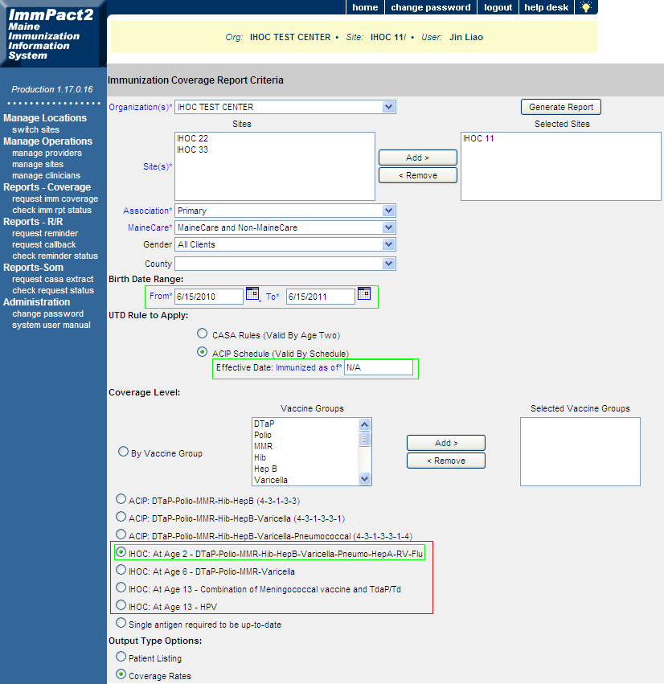
Generating IHOC Quick Pick Reports
Notes:
IHOC Quick Picks
4 IHOC immunization measures are added under the Coverage Level quick picks with the “IHOC” label as prefix (see red box in Figure 2 below). These 4 IHOC immunization measures mimic the mechanism that is run for CoCASA report, which meet the following criteria:
The report is run for clients who met the age criteria as of the 15th of the prior month.
This report includes only VALID doses given.
This report includes only doses given by or on their Birthday, Late-Up-To Dates are NOT included in your count and do count against your rate.
For IHOC quick pick - At Age 2, the system will count both 2-dose and 3-dose for Rotavirus vaccine depending on what type of vaccine was administered first. If Rotateq was administered as the first dose in a i3-dose series, 3 rotavirus doses will need to be given to be considered up to date. (UTD). If Rotarix was given first, 2 rotavirus vaccines will need to be given to be UTD.
For IHOC quick pick – At Age 2, flu vaccine is included in the combination rate. In the immunization reports that were provided by IHOC to First STEPS practices, the flu vaccine was reported as a separate measure for the previous flu season and not included in the combination rate
Each IHOC Quick Pick on the Immunization Coverage Report Criteria Page can generate two types of output for the IHOC Immunizations Measure rates in two versions —a spreadsheet (.csv or Excel) or a .pdf (Adobe):
Coverage Rates: Generates the practice’s rates for each of the single vacciness as well as a combination rate.
Patient Listing: Generates a list of the practice’s clients organized by those counted for (Up To Date) or against (not Up To Date) the practice’s rate. Please note that: The children who appear on the Patient Listing as being overdue for vaccines are those who did not have their immunizations Up To Date before or on their birthdate, based on the age criteria defined in each IHOC Quick Pick. This Patient List should not be used for Recall/Reminder because children on the list may have received immunizations after their birthdate, which means they could be Up To Date clinically at the time of the report. There is a separate Change Request in development to provide a Recall/Reminder list by IHOC Quick Pick.
Steps for Generating IHOC Immunization Measures
Simply apply the following steps to run any of the IHOC measures. Given “IHOC: At Age 2 - DTaP-Polio-MMR-Hib-HepB-Varicella-Pneumo-HepA-RV-Flu” as an example:
Select any organization/site that you are authorized to run report on.
Click one IHOC quick pick, the “Birth Date Range” would be automatically filled to meet any age criteria displayed in that IHOC quick pick. And the Immunized As of date is automatically filled as “N/A”. For example (see green box in the figure below):
Run report on “07/01/2013”
Select “IHOC: At Age 2 - DTaP-Polio-MMR-Hib-HepB-Varicella-Pneumo-HepA-RV-Flu”
Birth Date Range is automatically filled as “06/15/2010” to “06/15/2011”
Immunized As of date is automatically filled as “N/A”.
Select Output Type in the bottom of the page.
Click Generate Report on the top right of the page.
Wait until the report is 100% completed.
Select either the cvs or pdf format to open the report file. Sample Immunization reports for children immunization measure is partially displayed below:
maybe simpler language

Slide 14
ACO Influenza Measure
Can also run a report to capture influenza vaccine rates for children ages 6 months and older, which aligns with the CMS Accountable Care Organization (ACO) measure.
Note: The influenza vaccine is included in both the Childhood Immunization Status measure and the Influenza Immunization measure.
The Childhood Immunization Status measure corresponds to the Meaningful Use measure which only counts influenza vaccines for children by 2 years old.
The CMS ACO Influenza Immunization measure counts influenza vaccines for all clients aged 6 months and older, within the specified age range.

Slide 15
Questions?
Questions about reports should be directed to the ImmPact Support Line (1-800-906-8754)
Instructions on how to print IHOC Quick Pick and ACO Influenza reports are available at: http://www.mainequalitycounts.org/image_upload/IHOC%20Quick%20Picks%20in%20ImmPact%20Info%202-24-2014.pdf

Slide 16
Data is Great – But what do you do with it?
Measure current state of affairs - baseline
See where there are gaps
Focus on making small changes (PDSA cycles) – such as reminder/recall for a select vaccine or age
Track progress and ensure sustainability – look at it consistently and critically as a team

Slide 17
A Change Package: Evidence-based Approach to Improving Childhood Immunization Rates
Improving Immunizations Change Package Toolkit includes: system index, checklist of improvement ideas, action planning and full change package
Available on the Quality Counts Website: http://www.mainequalitycounts.org/page/2-688/phase-i-updates

