Slide 1
Regional Trainings 2014
Maine Immunization Program
Tonya Philbrick, BS, NCMA
Director

Slide 2
Immunization Rates
Make your shot count

Slide 3
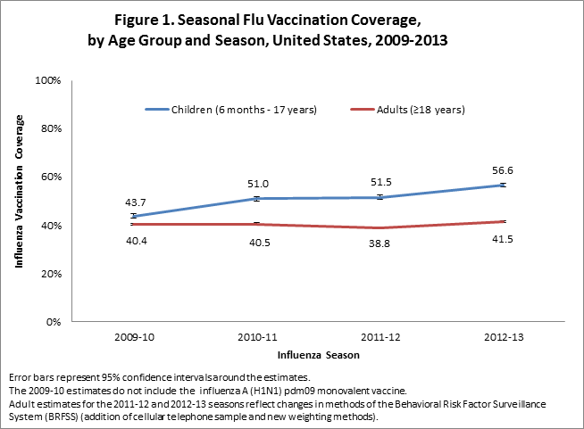
National Influenza Immunization Rates
Notes:
• Flu vaccination coverage among children increased by 5.1 percentage points for the 2012–13 season compared to the 2011–12 season and 12.9 percentage points from the 2009-10 season.
• Flu vaccination coverage among adults increased by 2.7 percentage points for the 2012-13 season compared to the 2011-12 season and 1.1 percentage points from the 2009-10 season.
Mention that Maine has seen a steady increase in Influenza Immunization Rates over the past 4 yrs.

Slide 4
Maine Influenza Vaccination Rates Children
Notes:
This slide is a representation of children influenza rates from 6months through 17 years.
Red is national rates
Grey are Maine rates
Maine has been above the national average since H1N1 in 2009-2010
Partnerships and Collaborations to offer children vaccine in non-traditional venues has shown that Maine can sustain being above the national average.

Slide 5
Maine Influenza Vaccination Rates Adults
Notes:
Adult Influenza Rates
All though adults influenza rates have dropped since H1N1 in 2009-2010, Maine has stilled been able maintain above the national average.

Slide 6
SCHOOL LOCATED VACCINE CLINICS
You have made a difference

Slide 7
SLVC Background
2009 H1N1
2011 CDC funds SLVC Project in Maine, 2 year collaborative project, Maine CDC, Maine DOE, Maine schools (implementation, billing, evaluation)
Purpose – increase the # of Maine students with access to flu vaccine by offering vaccine at school
We offered - no cost vaccine, SLVC Toolkit, ImmPact Registration, SLVC webpage & SLVC listserv
2013 Project extended for 1 additional year until August 2014, possibly a bit longer
Notes:
This is a collaborative effort with Maine DOE and the Maine CDC. With out the partners, schools and providers this could not be a success.

Slide 8
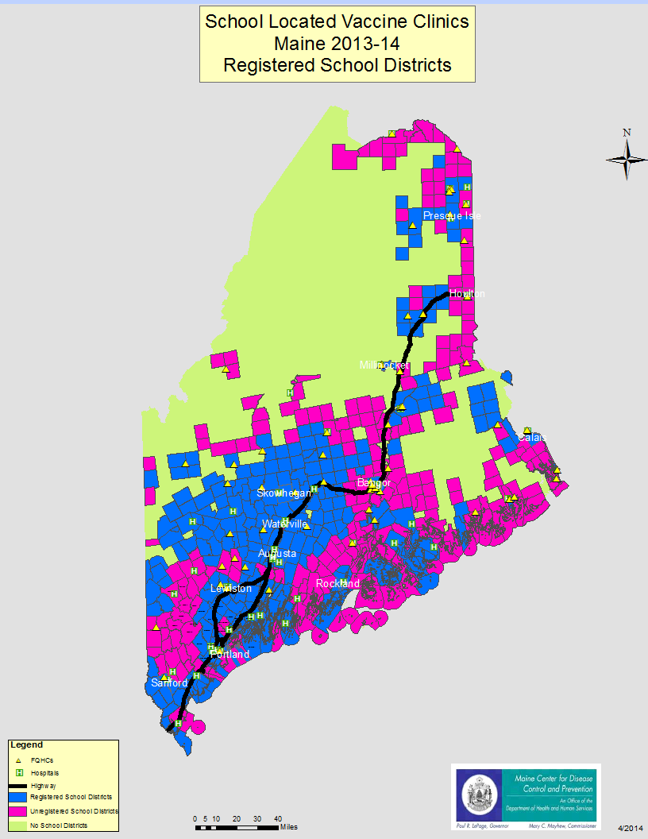
Where are the School Systems that held SLVC – 2013-14
Notes:
Pink is areas that did not hold a school located vaccine clinic.
Blue clinics were held.
Green: woods, or unorganized territories.

Slide 9
What happened?
 | 2012-13 School Year |  | 2013-14 School Year |  | % increase/ decrease
 | # | % | # | %
# School Systems | 85 | 44% | 104 | 53% | 22% increase # participating school systems
Enrollment* | 96,563 | 53% | 130,969 | 72% | 36% increase in # of students who have access to flu vaccine at school
Doses Administered | 18,747 |  | 28,988 |  | 54% increase in the # of doses administered at school
*Enrollment # represents the number of students who had access to flu shots at school,
ie. the total enrollment of school systems that offered SLVC
Notes:
A large accomplishment for this past year. Over 10,000 doses more administered in schools than the previous school season.

Slide 10
The Future of SLVC
Change in the SLVC Registration process
Increase the number of Registered Clinics
Requesting ongoing feedback from the Provider and School Communities
Its up to you
Notes:
The registration process has been revamped. Maine CDC has heard loud and clear that the process was daunting and time consuming. Stakeholders were brought to the table in early 2014 and based on feedback the registration process will be more stream lined for this upcoming season.

Slide 11
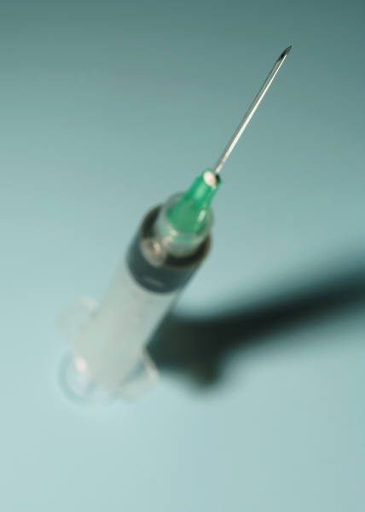
Vaccine supply
2014-2014 Product Availability from MIP

Slide 12
Quadrivalent
The following four viruses:
an A/California/7/2009 (H1N1)pdm09-like virus;
an A(H3N2) virus antigenically like the cell-propagated prototype virus A/Victoria/361/2011;
a B/Massachusetts/2/2012-like virus; and
a B/Brisbane/60/2008-like virus.
Notes:
The Maine Immunization Program will only offer Quadrivalent vaccine for the upcoming season.

Slide 13
Available Presentations Children
All children up to the 19th birthday
6-35months
Sanofi 49281-0514-25
.25ml Single dose syringe
36 months to the 19th birthday
GSK 58160-0901-52
Sanofi 49281-0414-50
.50ml Single dose syringe
MedImmune 66019-0301-10
Single Dose Sprayer
Notes:
Reiterate that FluMist from Medimmune is licensed for 2-49yrs, however with the funding utilized to purchase the product it can only be offered to 2-19 year olds.

Slide 14
Available Presentations Adult
Pregnant women and their partners (through health care providers who routinely care for pregnant women)
Residents and health care staff of long term care facilities and nursing homes
Any Underinsured or Uninsured adult in any setting (if the patient’s insurance does not cover vaccines or if the patient does not have insurance)
Employees of schools that provide onsite vaccine clinics on school days
All individuals served by Tribal Health Centers and Municipal Health Departments
Notes:
Review the criterea on the slides.

Slide 15
Available Presentations Adult (cont.)
Pregnant woman
Sanofi 49281-0414-50
.50ml Single dose syringe
All other adults
Sanofi 49281-0621-15
5ml multi-dose vial

Slide 16
Dosage and Administration 6 months through 8 Years of Age
For simplicity, this algorithm takes into consideration only doses of seasonal influenza vaccine received since July 1, 2010, to determine the number of doses needed for the 2014–15 season. As an alternative approach in settings where vaccination history from before July 1, 2010, is available, if a child aged 6 months through 8 years is known to have received either 1) at least 1 dose of 2013–14 seasonal influenza vaccine, or 2) at least two seasonal influenza vaccines during any previous season, and at least 1 dose of a 2009(H1N1)–containing vaccine (i.e., seasonal vaccine since 2010–11 or the monovalent 2009[H1N1] vaccine), then the child needs only 1 dose for 2014–15.
Using this approach, children aged 6 months through 8 years need only 1 dose of vaccine for 2014–15 if they have received any of the following: 1) at least 1 dose of 2013–14 seasonal influenza vaccine; or 2) 2 or more doses of seasonal influenza vaccine since July 1, 2010; or 3) 2 or more doses of seasonal influenza vaccine before July 1, 2010, and 1 or more doses of monovalent 2009(H1N1) vaccine; or 4) 1 or more doses of seasonal influenza vaccine before July 1, 2010, and 1 or more doses of seasonal influenza vaccine since July 1, 2010. Children in this age group for whom one of these conditions is not met require 2 doses for 2014–15.
Notes:
HAND OUT THE SCHEDULE
Ask if there is anyone who needs further guidance on the schedule.
Prevention and Control of Seasonal Influenza with Vaccines: Recommendations of the Advisory Committee on Immunization Practices (ACIP) — United States, 2014–15 Influenza Season
Weekly
August 15, 2014 / 63(32);691-697

Slide 17
Dosage and Administration 6 months through 8 Years of Age
Notes:
FIGURE 1. Influenza vaccine dosing algorithm for children aged 6 months through 8 years — Advisory Committee on Immunization Practices, United States, 2014–15 influenza season*
Children 6 months through 8 years of age for whom one of these conditions is not met require 2 doses in 2013-14.

Slide 18
Timing of Distribution
Mid-August
Vaccine Order Sets
Order what you need for a 6 week period
Record your doses administered
Use only the vaccine intended for the specific age groups.
Notes:
Key point after reviewing the slide
Record doses administered monthly:
Not only to have a correct inventory on hand
Updating patient records in a timely manner

Slide 19
Questions

