Slide 1
Civil Rights Data Collection (Federal Report)
Maine DOE Data Team Webinar
Alexandra Cookson – Data Quality Trainer
Kimberly Hall – Data Systems Manager

Slide 2
Agenda
What is the CRDC?
Overview of State uploaded CRDC elements
LEA and School Level
CRDC Reporting Resources
Overview of CRDC Resource Center
Questions

Slide 3
CRDC Overview
“The CRDC is a longstanding and important aspect of the U.S. Department of Education Office for Civil Rights' overall strategy for administering and enforcing civil rights laws that prohibit discrimination based on race, color, national origin, sex, disability, and age by schools, school districts and other entities that received Federal financial assistance from the Department.” (Civilrightsdata.ed.gov/about/crdc)

Slide 4
State of Maine Data Upload
The Maine Department of Education (MDOE) will be uploading 1,045 school level elements and 20 LEA level elements based on data that has been previously reported to the MDOE.
MDOE will not be uploading all elements of this report, LEAs will need to upload any data that is not included in the MDOE upload.

Slide 5
LEA Data (SAU/District)

Slide 6
School Data (School/Student)
Element | Definition | Source
School ID | NCES ID
School Status | Special Education/ Magnet/ Charter | Default No (unless MSSM, or Charter)
School Virtual Indicator | Whether school offers virtual instruction | Default No (with 2 exceptions)
School Justice Indicator | Whether entity can be characterized as a Justice Facility | Default No (with 2 exceptions)
School Grade Level Enrollments | Student enrollments per grade level | October 1 SY2022
Demographic/Service Grade Level Enrollments | IDEA, Race Ethnicity, English Learner, 504, Gifted and Talented | October 1 SY2022
Demographic/Service - Student Retention by Grade Level | IDEA, Race Ethnicity, English Learner, 504 | October 1 SY2022 compared to October 1 SY 2021

Slide 7
School Data cont. (Staff)
Element | Definition | Source
Total Teacher FTE | Total of FTE Teachers | NEO Staff December Snapshot – SY 2022
FTE of Certified Teachers | Total Certified and Not Certified Teachers | NEO Staff December Snapshot – SY 2022
Subject Matter Teacher FTE | Total FTE of teachers by subject matter | NEO Staff December Snapshot – SY 2022
FTE of First/Second Year Teachers | Total FTE of teachers in their first or second year of teaching | NEO Staff December Snapshot – SY 2022
FTE of Teachers who taught in the previous school year | Previous school year teachers | NEO Staff December Snapshot SY 2022 compared to SY 2021
FTE of additional staff | School Counselors, Nurses, Psychologists, Social Workers, Law Enforcement Officers, Security Guards | NEO Staff December Snapshot – SY 2022

Slide 8
School Data cont. (Behavior)
Element | Definition | Source
Expulsions/Suspensions | Single/Multiple incidents by race/ethnicity, 504, IDEA, English Learner | End of Year Behavior Data Snapshot SY 2022
Offenses | Robbery, Physical Attack/Fight, Threats of Physical Attack, Firearm/Explosive Possession, Rape/Attempted Rape, Sexual Assault, Homicide | Default 0 or No.

Slide 9
State Upload
Maine DOE will be uploading data for LEAs this week (12/4-12/8)
The CRDC report opens for LEAs on Monday, December 11, 2023
Due February 26, 2024
File Specifications from Maine State Upload (Excel File)

Slide 10
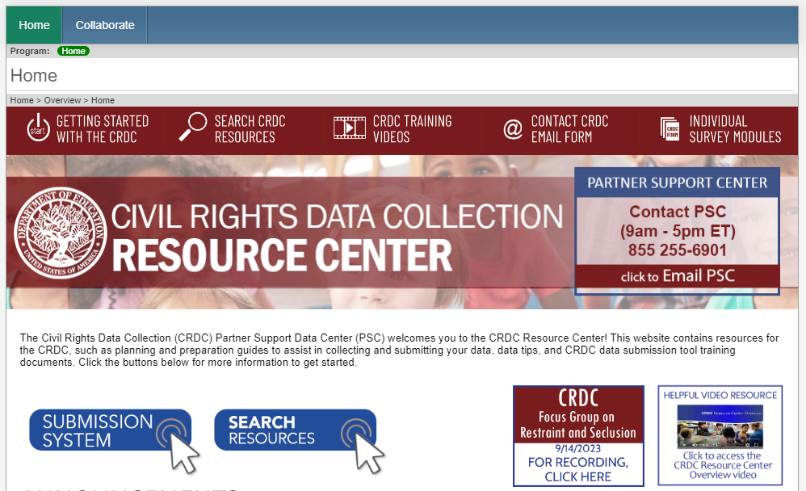
Resources
https://crdc.communities.ed.gov
Partner Support Center
855-255-6901
Hours 9am-5pm ET
crdc@aemcorp.com

Slide 12
Questions?

