Slide 1
Maine State Library
How to Navigate Employment Websites
Notes:
Welcome to the Maine State Library’s presentation on how to Navigate Job & Employment websites. Today we will discuss a few websites that you can browse to search employment opportunities. There are many more sites on internet. We are just focusing on the three most popular websites utilized in Maine.

Slide 2
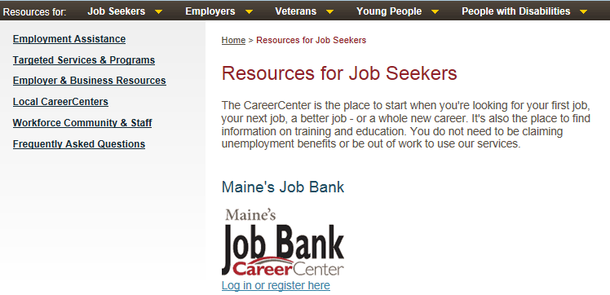
First Place to Start
Maine Career Center
  www.mainecareercenter.com/resources/jobseekers.shtml
Notes:
A good starting point for planning your search for employment is to start at the Maine Career Center. 1st thing to do is register with Maine’s Job Bank.
Make sure you have an e-mail address in order to complete the process. Yahoo and Google both offer free e-mail services.
The Maine State Library also offers online training on how to get Google email account. Simply type this link in your browser for a short video on how to setup an Google mail account: http://www.techgoeshome.org/index/876869
Try to keep your e-mail address as professional as possible. I would recommend using your name or a variation of your name if your first choice is unavailable.

Slide 3
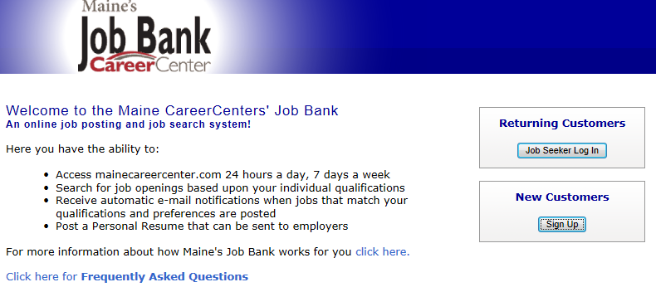
Maine’s Job Bank
Access 24 hours
Search for Job Openings
Receive e-mail notifications
Sign In New Customers
Notes:
Maine’s Job Bank is accessible 24 hours a day. You can search for job openings or upload a resume for employers to see. Once you open an account, you can receive e-mail notifications that match your search criteria. To start, sign up as a new customer in the lower right hand corner of the webpage.

Slide 4
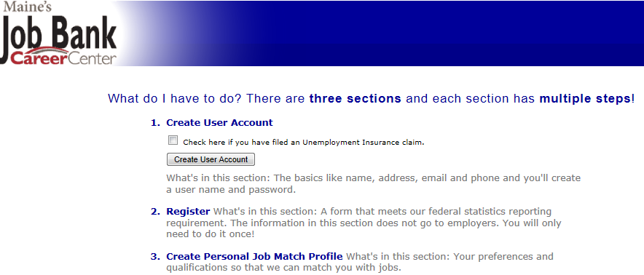
Complete 3 Steps to Use Job Bank
Create a User Account
Register
Create Personal Job Match Profile
Notes:
What do I have to do? There are three sections and each section has multiple steps!
1.Create User Account
Note: Don’t forget to check the box if you have filed an Unemployment Insurance claim.
What's in this section? The basics like name, address, email and phone and you'll create a user name and password.
2. Register. What's in this section? A form that meets their federal statistics reporting requirement. The information in this section does not go to employers. You will only need to do it once!
3. Create Personal Job Match Profile. What's in this section? Your preferences and qualifications so that they can match you with jobs from their job bank. These can be modified based on the results your get from your notifications. If you see you are not getting many notifications, you may want to modify your search parameters. If you are getting too many notifications, ones that don’t seem interesting or your not qualified, you may also want to modify your search parameters.
Once again as a reminder Don’t forget to check the box if you have filed an unemployment insurance claim.

Slide 5
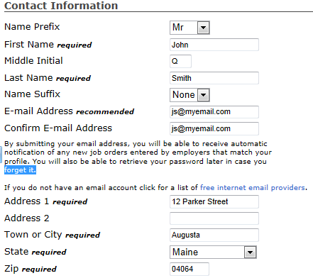
Create the Account
Notes:
This is the screen where you will fill out all of your contact information.
As you fill out the account information, make sure you fill in all the required blanks. It doesn’t hurt to double check your entries before moving to the next page.
Important: Errors in your application or information can affect your selection if the employer sees that you have mistakes on your application, or personal information is incorrect (for example, a phone number or email address) where the letters or numbers are transposed. This is a common mistake.

Slide 6
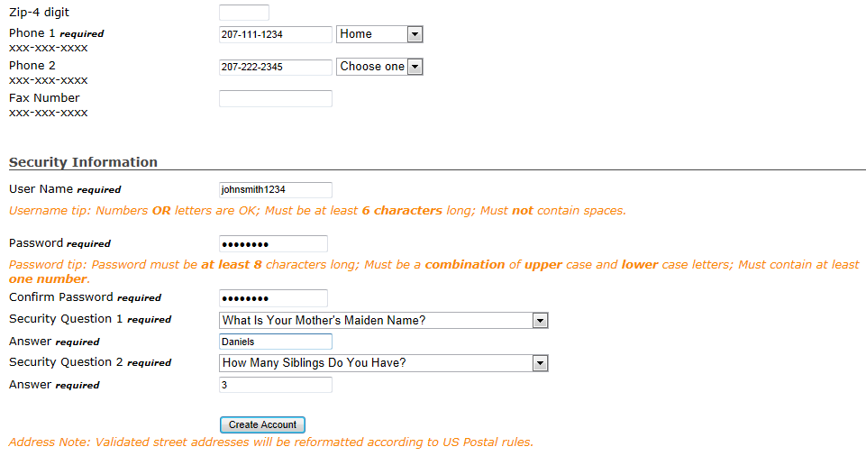
Create the Account (Continued)
Notes:
When putting your phone numbers in, I recommend using your cell phone as your primary number.
When filling in your User Name for job websites, try to use the same one every time you create an account so you don’t have to remember different logins for different websites.
Important: Do NOT choose user name and passwords that you use with your personal computer or financial websites.
Important: When building your security questions and answers, make sure you keep track of these if you should need these in the future.
Final step is to create the account and start your journey in finding your next position or career.

Slide 7



Upload Your Resume
You can upload your resume into the database in several formats:
  .rtf (Rich Text Format)
  .doc (Word Document)
  .txt (Text File)
  .odt (Open Document)
  .pdf (Adobe Portable Document Format)
Notes:
Can I upload my résumé? Yes, after you've created an account you will be able to upload your personal résumé and store it in Maine's Job Bank. Your résumé and your profile information will be made available to the employer when you submit a referral for an open position. You may upload your résumé for storage in .rtf, .doc, .txt, .odt, and .pdf formats.
Important: Be careful when uploading your resume. Make sure you check the website of the company and see what type of format they want the resume. This is a crucial step in getting your resume read. If it’s not in the right format, you may have just missed an opportunity for an interview because the person screening the applications was unable to open your resume.

Slide 8



Other Successful Websites to Check Out
www.indeed.com
www.myjobwave.com
www.monster.com
www.jobsinme.com
Notes:
Other successful websites to check out. These are just a few examples. Your local Maine Career Center has a list of over 30 websites you can use to help you with your search.

Slide 9

JobsInME.com
Flexible search options – Category, City, or Company
Job Alerts
Articles & Newsletters
Notes:
There are many advantages in using JobsInMe.com’s website. Here are a few examples of the features of this website:
Best Job Seeker Tools: Gain access to the best job hunting tools to accelerate your job search and put you in control of your career.
Flexible Search Options: Search for jobs with their easy-to-use interactive search tools that make your job hunting a snap.
Saved Search: Allows you to save your customized job searches and refer back to them as often as you need.
Job Alerts: You will receive Job Alerts automatically via email with jobs that meet your criteria.
Resume Posting: Post up to 10 resumes and be found by employers looking to hire people like you.
Apply Online: If you find a job on their website you can apply online with confidence using one of your pre-posted resumes.
Articles & Newsletters: Receive optional Career Connection newsletters packed with job hunting info that you can really use.
Exclusive Events: Get invited to exclusive career events and webinars that match your interests.

Slide 10
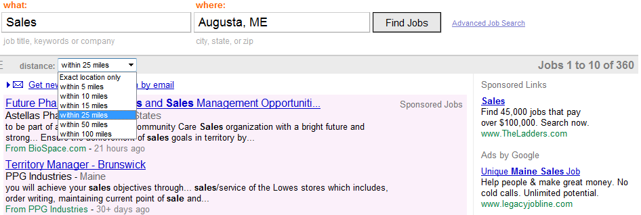

Employment Website: Indeed
Notes:
Indeed.com is another great tool in searching for that new career. This site is recommended by the Career Center and has lots of great tools at your disposal.
You can do a basic search starting on the home page. First start by typing words that describe what type of job you are looking for, what skills you have or an employer’s name. As an example here I put sales in the “what” column. Next type in location city and state, I’m using Augusta ME in the “where” column. Next hit the “Find Jobs” button or hit enter on your keyboard. Now you are at results page, as you can see on the top right hand corner that search gave us 360 possibilities. The area search defaults to 25 miles of the search area that you specified; however, you can change this by utilizing the drop down box just below the sales box. Below that you will see the first 10 listings of the results query.

Slide 11
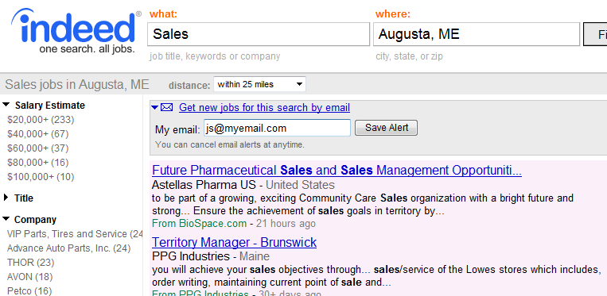
Indeed.com: Query Information
Notes:
Your results give you the title, the company name, the location, a brief description of the position, the original source and how old the posting is. You can narrow your search by utilizing the circled filters on the left hand side of the page.
If you want to be notified by e-mail when new jobs match your job description you can create a job alert. After successfully running your search, click on the save this search as an email job alert. I have already clicked the box. It is located just below the distance drop-down box. Enter your e-mail address and click the “Save Alert” button. You will receive a confirmation e-mail containing a link. You must click on the link in order to activate this option. After your alert is activated you should receive your e-mail within 24 hours.
If your search returns a large number of jobs there are several things you can do. First take a look at the refinement options on the left. I have circled a few of the options. By clicking on the refinement options this will give you a subset of your original search results. As another option, you can add more terms into the “what” box for example “Phone Sales” and hit your search button again. This will return fewer results, helping you define the exact position you are looking for. Once you find a link that is interesting, click on the blue link to visit the company’s website where you will find more details and instructions on how to apply for the position. If you want to return to your search results just click on the back button on your browser.

Slide 12
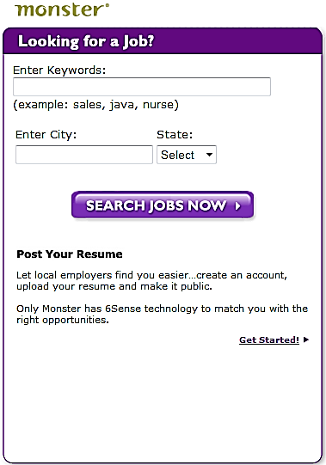
Monster.com
www.monster.com
Search by:
  Keywords
  City & State
You can also post your resume
Notes:
Monster.Com is another search tool you can use to look for jobs. Here you don’t have to sign in. Simply enter keywords that describe the position you are looking for and enter city and state and hit the “search jobs now” button to begin the search.

Slide 13
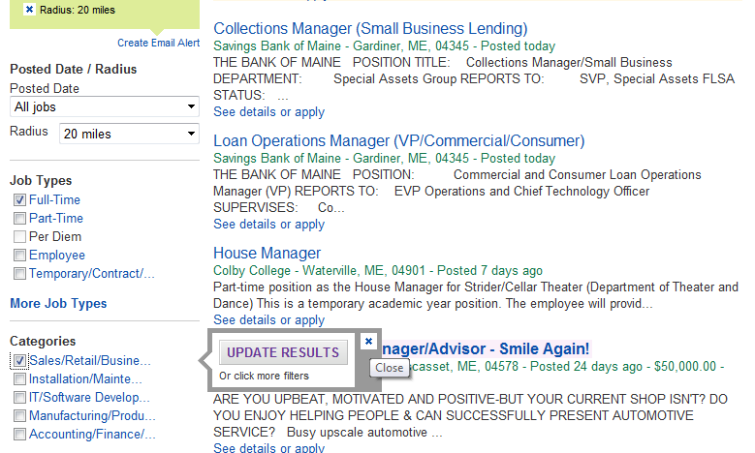
Monster.com: Query Listing
Notes:
As an example in this scenario I used “Manager” in “Augusta ME”. I got 29 results. I now can use the filters on the left hand side to update my results. As shown here after clicking sales/retail a pop-up button came up asking me to update my results and by doing do this decreased the number of search results, thereby defining my search. Some of the categories include:
Job Types, Industry, Career Levels, Education Level, Years of Experience just to name a few.
You also have the ability to expand the search radius (miles) by clicking on the option in the upper left hand corner.
You can also create an e-mail alert by signing up with them and building a profile.
The listings provide you with a title of the position, the company name, location, job description/summary. If you want to see more details or apply for the position, click on the blue link. Once you click on the link, Monster will redirect your browser to the company website for further instructions.
Monster also provides additional resources such as articles to read: Here are some sample articles:
Top 10 Interview Questions, Emerging High-Paying Jobs, Six Reasons They Didn't Call You Back, Four Cover Letter Flubs to Avoid, Sample Interview, Thank-You Letter, What to Wear to an Interview,
Resume Samples, Writing Your Resume Objective, Salary & Benefits

Slide 14

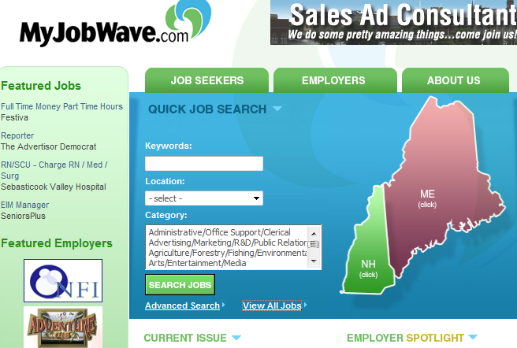
MyJobWave.com
Login is listed under Job Seekers
Search by:
  Keywords
  Category
  Employment Type
  Distance/Location
  Companies
Notes:
MyJobWave.com is yet another tool that can be very useful in your search for employment. Just like the other websites, MyJobWave.com offers you the ability to search throughout Maine and New Hampshire for employers.
This employment website has filters that allow you to narrow your search. You can search by Keywords, Category, Employment Type, and Companies, to name a few. MyJobWave.com has a list of featured jobs, featured employers, and featured events held at certain career centers. Sample featured events are : Job Search Skills, Resume Basics, Interview Skills etc. These are free to the public.
MyJobWave.com provides job seekers an easy-to-use tool to coordinate and manage your job search efforts. Available resources enhance your search through the Career Advisor that supplies articles published from Employment Times. You can read these online through their website.

Slide 15
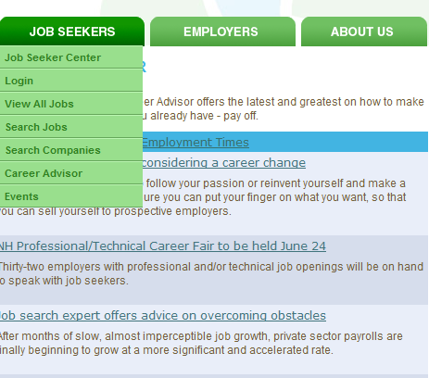
MyJobWave.com (Continued)
Career Advisor
Notes:
Career Advisor is updated each week, offering the latest and greatest on how to make your job search or your current job pay off.
This website offers excellent articles you can find under the career advisor tab.

Slide 16

Tips for your Job Search
Network, network, network
  Avoid only using websites to do your job search
Use a professional e-mail address
Be sure to proofread carefully – Ask other people
Use proper etiquette
Notes:
Don’t just rely on the internet to find that next position. The best possible way to get that interview or that job is to network with as many people as you can. The local Career Center offers networking suggestions and meetings. Talk to your friends and your family and let everyone know that you are looking. Statistics show that you will get hired faster by networking than just relying on the internet.
A marketing candidate sent a resume with the e-mail address: laughingcow@domain.com. The candidate may have been looking to stand out and get noticed. He definitely did, but not for the right reason. Make sure you have an alternate e-mail address, even if you need to establish one just for your job search. Use the professional one on your resume.
Proof reading your resume and your cover letter is extremely important; typos or grammar issues can be a deal breaker when searching for a job. Even if you think it looks good, ask other people to review and proof your resume and cover letters. Often others can catch mistakes you may miss.
ALWAYS send thank-you letters after an interview. You may not think this is very important but it is, and it is good business etiquette. Studies show nearly two-thirds of candidates neglect this crucial step. Not doing this can easily cost you the perfect job offer.

Slide 17

Temporary Agencies
Great way to find work
Differences offer opportunities
  Temporary
  Temp to hire
  Direct hire
Notes:
These employment agencies can be a great way to find work in times of need. As with anything though, there are both pros and cons that should be considered before using a temp agency for work.

Slide 18
Pros of Temporary Jobs
Excellent networking
Learning new skills
Won’t get boring
Try out different employers
Gets your foot in the door
Notes:
On of the major benefits to temporary jobs is that they offer great networking abilities. Each new company offers you an excellent opportunity to connect with new people, discover new clients, or even make new friends.
Another benefit of temporary jobs is that the work never has time to get boring. The work and working environment changes frequently with each temporary job worked, and it usually remains fresh enough for it not to become boring.
Temporary staffing jobs offer the unique opportunity to allow you to “try out” working for a company without there being any long term commitment involved. If for whatever reason you don’t like working at a particular temporary job, you can speak to your staffing agent and work a new temporary job. Temp employees don’t have to be committed to any of the employers, which makes it very easy to change temporary jobs and allows you to work where you want to.
Temporary jobs, especially temp to hire, allow you to get your foot in the door for companies that may not typically be hiring. Temp to hire jobs allow the employer to test you out before hiring you as well as letting you test the company out before deciding to apply and being hired full time. Temping therefore increases your chances of being hired in this way.
Every job a person works teaches new skills and increases the worth of the employee. When a temporary employee works several jobs in a short amount of time, this can increase his/her skills dramatically. These skills could be in new programs, customer service, new hardware, etc. By working several temporary jobs, you can gain many useful skills which look great on your resume!

Slide 19

Cons of Employment Agencies
Temp jobs don’t last
Lack of consistency
Little or NO Benefits
Reluctant to hire temp employees permanently.
Notes:
The major downside to temporary employment is that temporary staffing jobs don’t last, and there is no real guarantee that you will have steady or long term employment as a temp.
For many people the idea of this can be very stressful because as soon as the job is over, you are unemployed again. This stress can be alleviated by asking your staffing agency for “temp to hire” jobs that give the opportunity of being hired on permanently.
A potential problem that certain people have with staffing agencies is that the temporary work can be inconsistent, which can be stressful. If you are a person who enjoys consistency in their work and working environment, then a staffing agency may not be a good fit for you.
One of the major downsides to staffing agencies is that they provide inadequate benefits or no benefits at all for their employees working temporary jobs. During times like these when the economy is poor and healthcare costs so much, it’s extremely important to have health insurance and a savings plan like a 401(k). When choosing staffing agencies you’d like to work for, I highly recommend looking into the benefits they provide, and if they provide inadequate benefits, seeking insurance on your own.
A possible downside that can occur with a temporary job happens with temp to hire jobs. Some temporary jobs offer the opportunity of being hired on permanently if the temp performs well, but sometimes the employer can be reluctant to hire an agency temp because the temp is already providing the work needed at a lower cost. Some companies may also not want to pay a temp benefits or insurance either, which can be costly.

Slide 20
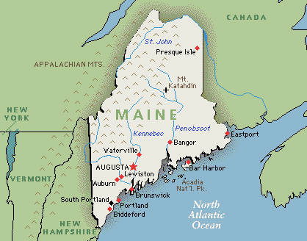
Several Agencies in Maine
  www.addecousa.com
  www.mainestaff.com
  www.bonneystaffing.com
  www.manpowerprofessional.com
  www.kellyservices.com
Notes:
I have listed just a few examples of staffing agencies: Adecco, Maine Staffing Group, Bonney Staffing, Manpower Professional and Kelly services

Slide 21

Beware of Employment Scams
Misleading
Be suspicious
Contract
BBB
No Social Security #s on application processes
Upfront money - NO
Notes:
Before you send any money responding to job ads or completing job placement contracts, the Better Business Bureau, along with the Federal Trade Commission, suggests that you:
Be suspicious of any employment-service firm that promises to get you a job.
Even if an employment service firm guarantees refunds to dissatisfied customers, check on their reliability with outside sources like the BBB or local consumer protection offices.
Do not give out your credit card or bank account information over the phone unless you are familiar with the company and agree to pay for something.
Anyone who has your account information can use it to take money from your accounts improperly.
Get a copy of the firm's contract and review it carefully before you pay any money. Understand the terms and conditions of the firm's refund policy. If oral promises are made that do not also appear in the contract, think twice about doing business with the firm.
Follow-up with the corporate offices of any company listed in an ad by an employment service, to find out if that company is really hiring.
Be wary of firms promoting "previously undisclosed" federal government jobs. All federal positions are announced to the public.
Check with the BBB to see if any complaints have been filed about a company with which you intend to do business.
Watch out for people requesting things out of the ordinary. No companies should be asking for your mother’s maiden name, passwords or social security number in the application process. And no legitimate organization will ask for money up front in exchange for a job, either. People would also be doing themselves a favor by independently verifying companies they do business with online. Take the extra few minutes to look up the company’s number and ask them if they are really offering the service they say they are.

